Slide 1
Parallel Programming with MPI
Slides available at https://anl.box.com/balaji-tutorials-2015/
Pavan Balaji
Argonne National Laboratory
Email: balaji@anl.gov
Web: http://www.mcs.anl.gov/~balaji

Slide 2
General principles in this tutorial
Everything is practically oriented
We will use lots of real example code to illustrate concepts
At the end, you should be able to use what you have learned and write real code, run real programs
Feel free to interrupt and ask questions
If our pace is too fast or two slow, let us know

Slide 3
What we will cover in this tutorial
What is MPI?
How to write a simple program in MPI
Running your application with MPICH
Slightly more advanced topics:
Non-blocking communication in MPI
Group (collective) communication in MPI
MPI Datatypes
Advanced topics:
Nonblocking Collectives
One-sided communication
Hybrid Programming
Network locality and Topology
What’s coming in MPI-4
Conclusions and Final Q/A

Slide 4
The switch from sequential to parallel computing
Moore’s law continues to be true, but…
Processor speeds no longer double every 18-24 months
Number of processing units double, instead
Multi-core chips (dual-core, quad-core)
No more automatic increase in speed for software
Parallelism is the norm
Lots of processors connected over a network and coordinating to solve large problems
Used every where!
By USPS for tracking and minimizing fuel routes
By automobile companies for car crash simulations
By airline industry to build newer models of flights

Slide 5
Sample Parallel Programming Models
Shared Memory Programming
Processes share memory address space (threads model)
Application ensures no data corruption (Lock/Unlock)
Transparent Parallelization
Compiler works magic on sequential programs
Directive-based Parallelization
Compiler needs help (e.g., OpenMP)
Message Passing
Explicit communication between processes (like sending and receiving emails)

Slide 6
The Message-Passing Model
A process is (traditionally) a program counter and address space.
Processes may have multiple threads (program counters and associated stacks) sharing a single address space. MPI is for communication among processes, which have separate address spaces.
Inter-process communication consists of
synchronization
movement of data from one process’s address space to another’s.
Process
MPI
Process
MPI

Slide 7
The Message-Passing Model (an example)
Each process has to send/receive data to/from other processes
Example: Sorting Integers
Process1
O(N log N)
8
23
19
67
45
35
1
24
13
30
3
5
Process1
Process2
8
19
23
35
45
67
1
3
5
13
24
30
O(N/2 log N/2)
O(N/2 log N/2)
1
3
5
8
13
19
23
24
30
35
45
67
O(N)
Process1

Slide 8
Standardizing Message-Passing Models with MPI
Early vendor systems (Intel’s NX, IBM’s EUI, TMC’s CMMD) were not portable (or very capable)
Early portable systems (PVM, p4, TCGMSG, Chameleon) were mainly research efforts
Did not address the full spectrum of message-passing issues
Lacked vendor support
Were not implemented at the most efficient level
The MPI Forum was a collection of vendors, portability writers and users that wanted to standardize all these efforts

Slide 9
What is MPI?
MPI: Message Passing Interface
The MPI Forum organized in 1992 with broad participation by:
Vendors: IBM, Intel, TMC, SGI, Convex, Meiko
Portability library writers: PVM, p4
Users: application scientists and library writers
MPI-1 finished in 18 months
Incorporates the best ideas in a “standard” way
Each function takes fixed arguments
Each function has fixed semantics
Standardizes what the MPI implementation provides and what the application can and cannot expect
Each system can implement it differently as long as the semantics match
MPI is not…
a language or compiler specification
a specific implementation or product

Slide 10
MPI-1
MPI-1 supports the classical message-passing programming model: basic point-to-point communication, collectives, datatypes, etc
MPI-1 was defined (1994) by a broadly based group of parallel computer vendors, computer scientists, and applications developers.
2-year intensive process
Implementations appeared quickly and now MPI is taken for granted as vendor-supported software on any parallel machine.
Free, portable implementations exist for clusters and other environments (MPICH, Open MPI)
10

Slide 11
Following MPI Standards
MPI-2 was released in 1997
Several additional features including MPI + threads, MPI-I/O, remote memory access functionality and many others
MPI-2.1 (2008) and MPI-2.2 (2009) were recently released with some corrections to the standard and small features
MPI-3 (2012) added several new features to MPI
MPI-3.1 (2015) is the latest version of the standard with minor corrections and features
The Standard itself:
at http://www.mpi-forum.org
All MPI official releases, in both postscript and HTML
Other information on Web:
at http://www.mcs.anl.gov/mpi
pointers to lots of material including tutorials, a FAQ, other MPI pages

Slide 12
MPI-2
Same process of definition by MPI Forum
MPI-2 is an extension of MPI
Extends the message-passing model.
Parallel I/O
Remote memory operations (one-sided)
Dynamic process management
Adds other functionality
C++ and Fortran 90 bindings
similar to original C and Fortran-77 bindings
External interfaces
Language interoperability
MPI interaction with threads
12

Slide 13
Overview of New Features in MPI-3
Major new features
Nonblocking collectives
Neighborhood collectives
Improved one-sided communication interface
Tools interface
Fortran 2008 bindings
Other new features
Matching Probe and Recv for thread-safe probe and receive
Noncollective communicator creation function
“const” correct C bindings
Comm_split_type function
Nonblocking Comm_dup
Type_create_hindexed_block function
C++ bindings removed
Previously deprecated functions removed
MPI 3.1 added nonblocking collective I/O functions

Slide 14
Status of MPI-3.1 Implementations
 | MPICH | MVAPICH | Open MPI | Cray MPI | Tianhe MPI | Intel MPI | IBM BG/Q MPI¹ | IBM PE MPICH² | IBM Platform | SGI MPI | Fujitsu MPI | MS MPI | MPC
NBC | ✔ | ✔ | ✔ | ✔ | ✔ | ✔ | ✔ | ✔ | ✔ | ✔ | ✔ | (*) | Q4’15
Nbrhood collectives | ✔ | ✔ | ✔ | ✔ | ✔ | ✔ | ✔ | ✔ |  | ✔ |  |  | Q4’15
RMA | ✔ | ✔ | ✔ | ✔ | ✔ | ✔ | ✔ | ✔ |  | ✔ |  |  | *
Shared memory | ✔ | ✔ | ✔ | ✔ | ✔ | ✔ | ✔ | ✔ |  | ✔ |  | ✔ | *
Tools Interface | ✔ | ✔ | ✔ | ✔ | ✔ | ✔ | ✔ | ✔ |  | ✔ |  | * | Q4’16
Comm-creat group | ✔ | ✔ | ✔ | ✔ | ✔ | ✔ | ✔ | ✔ |  | ✔ |  |  | *
F08 Bindings | ✔ | ✔ | ✔ | ✔ | ✔ |  | ✔ |  |  | ✔ |  |  | Q2’16
New Datatypes | ✔ | ✔ | ✔ | ✔ | ✔ | ✔ | ✔ | ✔ |  | ✔ |  | ✔ | Q4’15
Large Counts | ✔ | ✔ | ✔ | ✔ | ✔ | ✔ | ✔ | ✔ |  | ✔ |  | ✔ | Q2’16
Matched Probe | ✔ | ✔ | ✔ | ✔ | ✔ | ✔ | ✔ | ✔ |  | ✔ | ✔ | ✔ | Q2’16
NBC I/O | ✔ | Q1‘16 |  | Q4‘15 |  |  |  |  |  | Q2‘16
Release dates are estimates and are subject to change at any time.
Empty cells indicate no publicly announced plan to implement/support that feature.
Platform-specific restrictions might apply for all supported features
¹ Open Source but unsupported ² No MPI_T variables exposed * Under development (*) Partly done

Slide 15
Web Pointers
MPI Standard : http://www.mpi-forum.org/docs/docs.html
MPI Forum : http://www.mpi-forum.org/
MPI implementations:
MPICH : http://www.mpich.org
MVAPICH : http://mvapich.cse.ohio-state.edu/
Intel MPI: http://software.intel.com/en-us/intel-mpi-library/
Microsoft MPI: www.microsoft.com/en-us/download/details.aspx?id=39961
Open MPI : http://www.open-mpi.org/
IBM MPI, Cray MPI, HP MPI, TH MPI, …
Several MPI tutorials can be found on the web

Slide 16
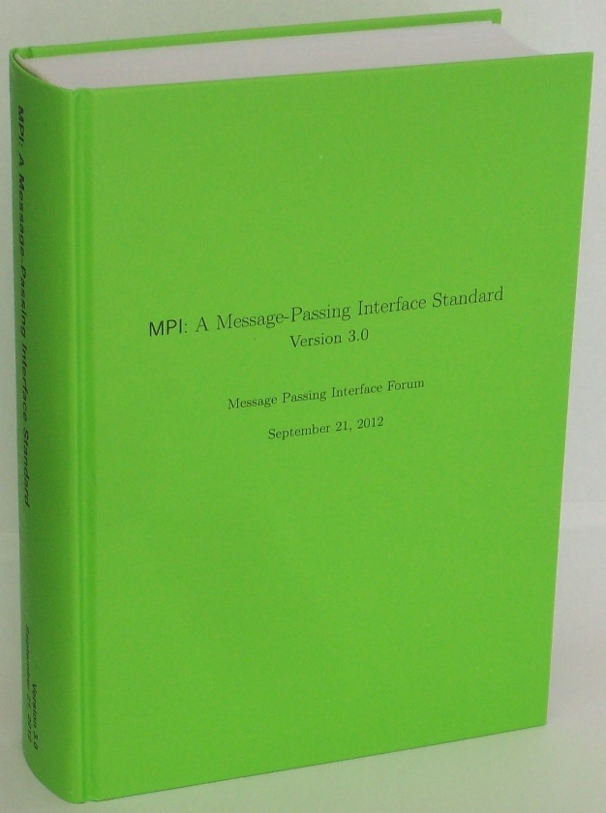
MPI 3.0 Standard in Book Form
Available from amazon.com
http://www.amazon.com/dp/B002TM5BQK/

Slide 17
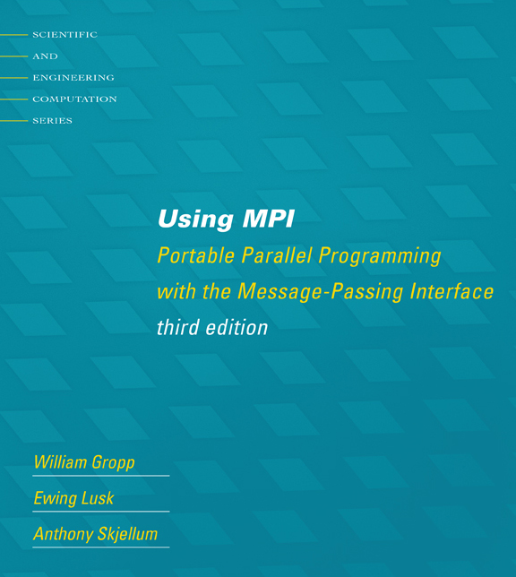
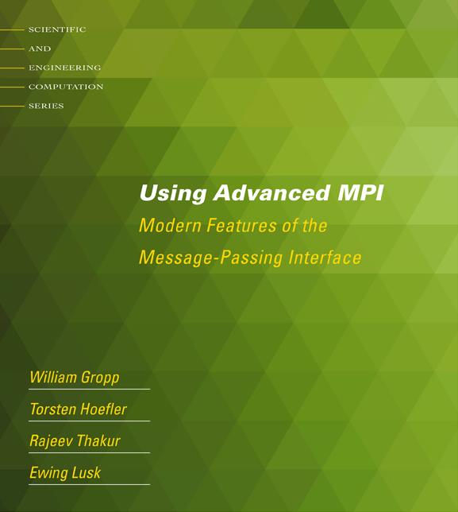
New Tutorial Books on MPI
Basic MPI
Advanced MPI, including MPI-3

Slide 18
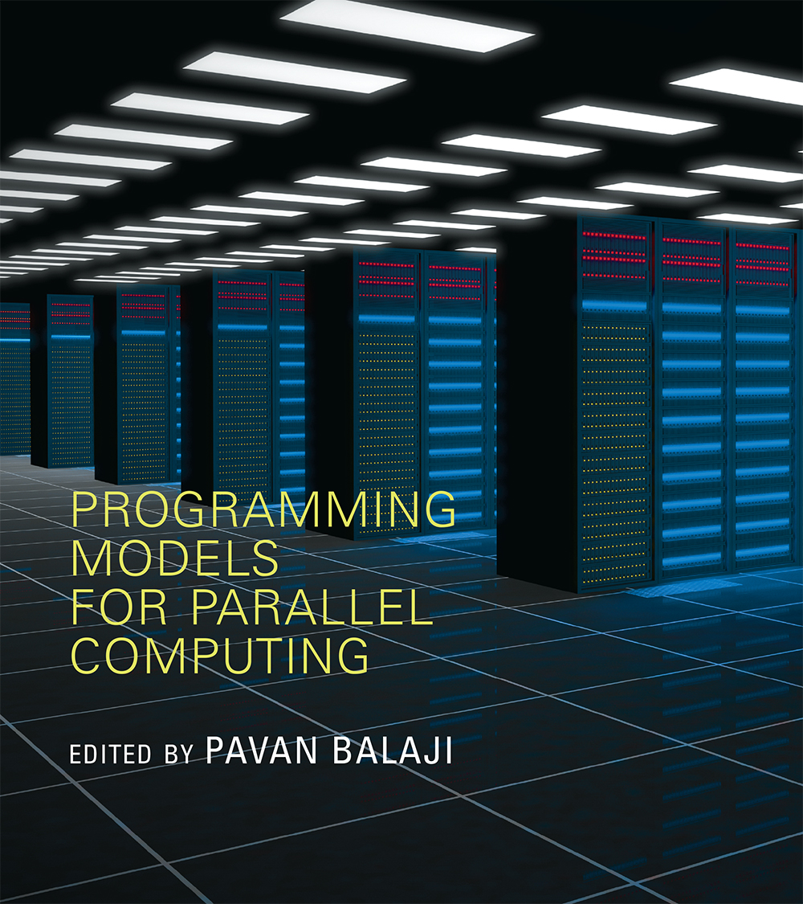
New Book on Parallel Programming Models
Released at SC15
Edited by Pavan Balaji
MPI: W. Gropp and R. Thakur
GASNet: P. Hargrove
OpenSHMEM: J. Kuehn and S. Poole
UPC: K. Yelick and Y. Zheng
Global Arrays: S. Krishnamoorthy, J. Daily, A. Vishnu, and B. Palmer
Chapel: B. Chamberlain
Charm++: L. Kale, N. Jain, and J. Lifflander
ADLB: E. Lusk, R. Butler, and S. Pieper
Scioto: J. Dinan
SWIFT: T. Armstrong, J. M. Wozniak, M. Wilde, and I. Foster
CnC: K. Knobe, M. Burke, and F. Schlimbach
OpenMP: B. Chapman, D. Eachempati, and S. Chandrasekaran
Cilk Plus: A. Robison and C. Leiserson
Intel TBB: A. Kukanov
CUDA: W. Hwu and D. Kirk
OpenCL: T. Mattson
Pre-order at https://mitpress.mit.edu/models
Discount code: MBALAJI30 (valid till 12/31/2015)

Slide 19
Applications (Science and Engineering)
MPI is widely used in large scale parallel applications in science and engineering
Atmosphere, Earth, Environment
Physics - applied, nuclear, particle, condensed matter, high pressure, fusion, photonics
Bioscience, Biotechnology, Genetics
Chemistry, Molecular Sciences
Geology, Seismology
Mechanical Engineering - from prosthetics to spacecraft
Electrical Engineering, Circuit Design, Microelectronics
Computer Science, Mathematics

Slide 20


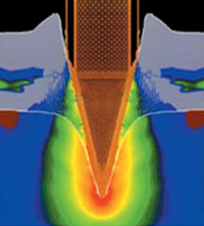
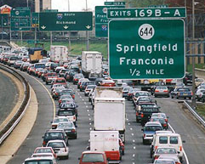

Turbo machinery (Gas turbine/compressor)
Biology application
Transportation & traffic application
Drilling application
Astrophysics application
20

Slide 21
Reasons for Using MPI
Standardization - MPI is the only message passing library which can be considered a standard. It is supported on virtually all HPC platforms. Practically, it has replaced all previous message passing libraries
Portability - There is no need to modify your source code when you port your application to a different platform that supports (and is compliant with) the MPI standard
Performance Opportunities - Vendor implementations should be able to exploit native hardware features to optimize performance
Functionality – Rich set of features
Availability - A variety of implementations are available, both vendor and public domain
MPICH is a popular open-source and free implementation of MPI
Vendors and other collaborators take MPICH and add support for their systems
Intel MPI, IBM Blue Gene MPI, Cray MPI, Microsoft MPI, MVAPICH, MPICH-MX

Slide 22
Important considerations while using MPI
All parallelism is explicit: the programmer is responsible for correctly identifying parallelism and implementing parallel algorithms using MPI constructs

Slide 23
Approach in this Tutorial
Example driven
2D stencil code used as a running example throughout the tutorial
Other examples used to illustrate specific features
Will walk through actual code
23

Slide 24
What we will cover in this tutorial
What is MPI?
How to write a simple program in MPI
Running your application with MPICH
Slightly more advanced topics:
Non-blocking communication in MPI
Group (collective) communication in MPI
MPI Datatypes
Advanced topics:
Nonblocking Collectives
One-sided communication
Hybrid Programming
Network locality and Topology
What’s coming in MPI-4
Conclusions and Final Q/A

Slide 25


How does MPI work? (1/2)

Slide 26
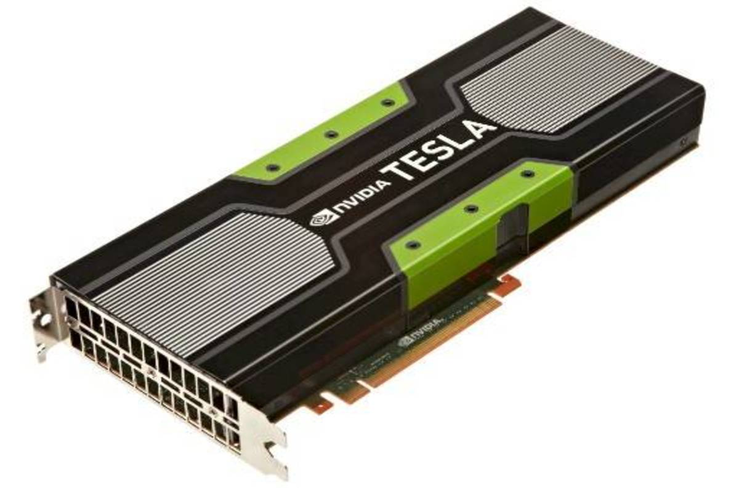
How does MPI work? Multicore Systems. (2/2)

Slide 27
MPI Basic Send/Receive
Simple communication model
Application needs to specify to the MPI implementation:
How do you compile and run an MPI application?
How will processes be identified?
How will “data” be described?
Process 0
Process 1
Send(data)
Receive(data)

Slide 28
Compiling and Running MPI applications (more details later)
MPI is a library
Applications can be written in C, C++ or Fortran and appropriate calls to MPI can be added where required
Compilation:
Regular applications:
gcc test.c -o test
MPI applications
mpicc test.c -o test
Execution:
Regular applications
./test
MPI applications (running with 16 processes)
mpiexec –n 16 ./test

Slide 29
Process Identification
MPI processes can be collected into groups
Each group can have multiple colors (some times called context)
Group + color == communicator (it is like a name for the group)
When an MPI application starts, the group of all processes is initially given a predefined name called MPI_COMM_WORLD
The same group can have many names, but simple programs do not have to worry about multiple names
A process is identified by a unique number within each communicator, called rank
For two different communicators, the same process can have two different ranks: so the meaning of a “rank” is only defined when you specify the communicator

Slide 30
Communicators
mpiexec -n 16 ./test
When you start an MPI program, there is one predefined communicator MPI_COMM_WORLD
Communicators do not need to contain all processes in the system
0
1
0
1
2
2
3
3
Every process in a communicator has an ID called a “rank”
4
5
Can make copies of this communicator (same group of processes, but different “aliases”)
4
6
5
7
6
7
The same process might have different ranks in different communicators
Communicators can be created “by hand” or using tools provided by MPI (not discussed in this tutorial)
Simple programs typically only use the predefined communicator MPI_COMM_WORLD

Slide 31
Simple MPI Program Identifying Processes
#include <mpi.h>
#include <stdio.h>
int main(int argc, char ** argv)
{
int rank, size;
MPI_Init(&argc, &argv);
MPI_Comm_rank(MPI_COMM_WORLD, &rank);
MPI_Comm_size(MPI_COMM_WORLD, &size);
printf("I am %d of %d\n", rank + 1, size);
MPI_Finalize();
return 0;
}
Basic requirements for an MPI program
Notes:
See hello.c in examples/ folder

Slide 32
Code Example
intro-hello.c
Notes:
Remember to run example a couple times to show how output is re-ordered.

Slide 33
Data Communication
Data communication in MPI is like email exchange
One process sends a copy of the data to another process (or a group of processes), and the other process receives it
Communication requires the following information:
Sender has to know:
Whom to send the data to (receiver’s process rank)
What kind of data to send (100 integers or 200 characters, etc)
A user-defined “tag” for the message (think of it as an email subject; allows the receiver to understand what type of data is being received)
Receiver “might” have to know:
Who is sending the data (OK if the receiver does not know; in this case sender rank will be MPI_ANY_SOURCE, meaning anyone can send)
What kind of data is being received (partial information is OK: I might receive up to 1000 integers)
What the user-defined “tag” of the message is (OK if the receiver does not know; in this case tag will be MPI_ANY_TAG)

Slide 34
More Details on Describing Data for Communication
MPI Datatype is very similar to a C or Fortran datatype
int → MPI_INT
double → MPI_DOUBLE
char → MPI_CHAR
More complex datatypes are also possible:
E.g., you can create a structure datatype that comprises of other datatypes → a char, an int and a double.
Or, a vector datatype for the columns of a matrix
The “count” in MPI_SEND and MPI_RECV refers to how many datatype elements should be communicated

Slide 35
MPI Basic (Blocking) Send
MPI_Send(void *buf, int count, MPI_Datatype datatype,
int dest, int tag, MPI_Comm comm)
The message buffer is described by (buf, count, datatype).
The target process is specified by dest and comm.
dest is the rank of the target process in the communicator specified by comm.
tag is a user-defined “type” for the message
When this function returns, the data has been delivered to the system and the buffer can be reused.
The message may not have been received by the target process.

Slide 36
MPI Basic (Blocking) Receive
MPI_Recv(void *buf, int count, MPI_Datatype datatype,
int source, int tag, MPI_Comm comm, MPI_Status *status)
Waits until a matching (on source, tag, comm) message is received from the system, and the buffer can be used.
source is rank in communicator comm, or MPI_ANY_SOURCE.
Receiving fewer than count occurrences of datatype is OK, but receiving more is an error.
status contains further information:
Who sent the message (can be used if you used MPI_ANY_SOURCE)
How much data was actually received
What tag was used with the message (can be used if you used MPI_ANY_TAG)
MPI_STATUS_IGNORE can be used if we don’t need any additional information

Slide 37
Simple Communication in MPI
#include <mpi.h>
#include <stdio.h>
int main(int argc, char ** argv)
{
int rank, data[100];
MPI_Init(&argc, &argv);
MPI_Comm_rank(MPI_COMM_WORLD, &rank);
if (rank == 0)
MPI_Send(data, 100, MPI_INT, 1, 0, MPI_COMM_WORLD);
else if (rank == 1)
MPI_Recv(data, 100, MPI_INT, 0, 0, MPI_COMM_WORLD,
MPI_STATUS_IGNORE);
MPI_Finalize();
return 0;
}
Notes:
Important concept is that each process is running the same program. Difference in rank determines behavior.

Slide 38
Code Example
intro-sendrecv.c

Slide 39
Parallel Sort using MPI Send/Recv
Rank 0
8
23
19
67
45
35
1
24
13
30
3
5
O(N log N)
Rank 0
Rank 1
8
19
23
35
45
67
1
3
5
13
24
30
O(N/2 log N/2)
Rank 0
8
19
23
35
45
67
1
3
5
13
24
30
O(N)
Rank 0
1
3
5
8
13
19
23
24
30
35
45
67

Slide 40
Parallel Sort using MPI Send/Recv (contd.)
#include <mpi.h>
#include <stdio.h>
int main(int argc, char ** argv)
{
int rank, a[1000], b[500];
MPI_Init(&argc, &argv);
MPI_Comm_rank(MPI_COMM_WORLD, &rank);
if (rank == 0) {
MPI_Send(&a[500], 500, MPI_INT, 1, 0, MPI_COMM_WORLD);
sort(a, 500);
MPI_Recv(b, 500, MPI_INT, 1, 0, MPI_COMM_WORLD,
MPI_STATUS_IGNORE);
/* Serial: Merge array b and sorted part of array a */
}
else if (rank == 1) {
MPI_Recv(b, 500, MPI_INT, 0, 0, MPI_COMM_WORLD,
MPI_STATUS_IGNORE);
sort(b, 500);
MPI_Send(b, 500, MPI_INT, 0, 0, MPI_COMM_WORLD);
}
MPI_Finalize(); return 0;
}

Slide 41
Status Object
The status object is used after completion of a receive to find the actual length, source, and tag of a message
Status object is MPI-defined type and provides information about:
The source process for the message (status.MPI_SOURCE)
The message tag (status.MPI_TAG)
Error status (status.MPI_ERROR)
The number of elements received is given by:
MPI_Get_count(MPI_Status *status, MPI_Datatype datatype, int *count)
status return status of receive operation (status) datatype datatype of each receive buffer element (handle)
count number of received elements (integer)(OUT)

Slide 42
Using the “status” field
Task 1
Task 2
Each “worker process” computes some task (maximum 100 elements) and sends it to the “master” process together with its group number: the “tag” field can be used to represent the task
Data count is not fixed (maximum 100 elements)
Order in which workers send output to master is not fixed (different workers = different source ranks, and different tasks = different tags)

Slide 43
Using the “status” field (contd.)
#include <mpi.h>
#include <stdio.h>
int main(int argc, char ** argv)
{
[...snip...]
if (rank != 0) /* worker process */
MPI_Send(data, rand() % 100, MPI_INT, 0, group_id,
MPI_COMM_WORLD);
else { /* master process */
for (i = 0; i < size – 1; i++) {
MPI_Recv(data, 100, MPI_INT, MPI_ANY_SOURCE,
MPI_ANY_TAG, MPI_COMM_WORLD, &status);
MPI_Get_count(&status, MPI_INT, &count);
printf(“worker ID: %d; task ID: %d; count: %d\n”,
status.MPI_SOURCE, status.MPI_TAG, count);
}
}
[...snip...]
}

Slide 44
MPI is Simple
Many parallel programs can be written using just these six functions, only two of which are non-trivial:
MPI_INIT – initialize the MPI library (must be the first routine called)
MPI_COMM_SIZE - get the size of a communicator
MPI_COMM_RANK – get the rank of the calling process in the communicator
MPI_SEND – send a message to another process
MPI_RECV – send a message to another process
MPI_FINALIZE – clean up all MPI state (must be the last MPI function called by a process)
For performance, however, you need to use other MPI features

Slide 45
What we will cover in this tutorial
What is MPI?
How to write a simple program in MPI
Running your application with MPICH
Slightly more advanced topics:
Non-blocking communication in MPI
Group (collective) communication in MPI
MPI Datatypes
Advanced topics:
Nonblocking Collectives
One-sided communication
Hybrid Programming
Network locality and Topology
What’s coming in MPI-4
Conclusions and Final Q/A

Slide 46
What is MPICH
MPICH is a high-performance and widely portable open-source implementation of MPI
It provides all features of MPI that have been defined so far (including MPI-1, MPI-2.0, MPI-2.1, MPI-2.2, MPI-3.0 and MPI-3.1)
Active development lead by Argonne National Laboratory and University of Illinois at Urbana-Champaign
Several close collaborators who contribute many features, bug fixes, testing for quality assurance, etc.
IBM, Microsoft, Cray, Intel, Ohio State University, Queen’s University, Myricom and many others
Current release is MPICH-3.2

Slide 47
Getting Started with MPICH
Download MPICH
Go to http://www.mpich.org and follow the downloads link
The download will be a zipped tarball
Build MPICH
Unzip/untar the tarball
tar xvfz mpich-3.2.tar.gz
cd mpich-3.2
./configure –-prefix=/where/to/install/mpich |& tee c.log
make |& tee m.log
make install |& tee mi.log
Add /where/to/install/mpich/bin to your PATH

Slide 48
Compiling MPI programs with MPICH
Compilation Wrappers
For C programs: mpicc test.c –o test
For C++ programs: mpicxx test.cpp –o test
For Fortran programs: mpifort test.f90 –o test
You can link other libraries are required too
To link to a math library: mpicc test.c –o test -lm
You can just assume that “mpicc” and friends have replaced your regular compilers (gcc, gfortran, etc.)

Slide 49
Running MPI programs with MPICH
Launch 16 processes on the local node:
mpiexec –n 16 ./test
Launch 16 processes on 4 nodes (each has 4 cores)
mpiexec –hosts h1:4,h2:4,h3:4,h4:4 –n 16 ./test
Runs the first four processes on h1, the next four on h2, etc.
mpiexec –hosts h1,h2,h3,h4 –n 16 ./test
Runs the first process on h1, the second on h2, etc., and wraps around
So, h1 will have the 1st, 5th, 9th and 13th processes
If there are many nodes, it might be easier to create a host file
cat hf
h1:4
h2:2
mpiexec –hostfile hf –n 16 ./test

Slide 50
Trying some example programs
MPICH comes packaged with several example programs using almost ALL of MPICH’s functionality
A simple program to try out is the PI example written in C (cpi.c) – calculates the value of PI in parallel (available in the examples directory when you build MPICH)
mpiexec –n 16 ./examples/cpi
The output will show how many processes are running, and the error in calculating PI
Next, try it with multiple hosts
mpiexec –hosts h1:2,h2:4 –n 16 ./examples/cpi
If things don’t work as expected, send an email to discuss@mpich.org

Slide 51
Interaction with Resource Managers
Resource managers such as SGE, PBS, SLURM or Loadleveler are common in many managed clusters
MPICH automatically detects them and interoperates with them
For example with PBS, you can create a script such as:
#! /bin/bash
cd $PBS_O_WORKDIR
# No need to provide –np or –hostfile options
mpiexec ./test
Job can be submitted as: qsub –l nodes=2:ppn=2 test.sub
“mpiexec” will automatically know that the system has PBS, and ask PBS for the number of cores allocated (4 in this case), and which nodes have been allocated
The usage is similar for other resource managers

Slide 52
Debugging MPI programs
Parallel debugging is trickier than debugging serial programs
Many processes computing; getting the state of one failed process is usually hard
MPICH provides in-built support for debugging
It natively interoperates with commercial parallel debuggers such as Totalview and DDT
Using MPICH with totalview:
totalview –args mpiexec –n 6 ./test
Using MPICH with gdb on one process:
mpiexec –n 4 ./test : -n 1 gdb ./test : -n 1 ./test
Launches the 5th process under “gdb” and all other processes normally

Slide 53
What we will cover in this tutorial
What is MPI?
How to write a simple program in MPI
Running your application with MPICH
Slightly more advanced topics:
Non-blocking communication in MPI
Group (collective) communication in MPI
MPI Datatypes
Advanced topics:
Nonblocking Collectives
One-sided communication
Hybrid Programming
Network locality and Topology
What’s coming in MPI-4
Conclusions and Final Q/A

Slide 54
Blocking vs. Non-blocking Communication
MPI_SEND/MPI_RECV are blocking communication calls
Return of the routine implies completion
When these calls return the memory locations used in the message transfer can be safely accessed for reuse
For “send” completion implies variable sent can be reused/modified
Modifications will not affect data intended for the receiver
For “receive” variable received can be read
MPI_ISEND/MPI_IRECV are non-blocking variants
Routine returns immediately – completion has to be separately tested for
These are primarily used to overlap computation and communication to improve performance

Slide 55
Blocking Communication
In blocking communication.
MPI_SEND does not return until buffer is empty (available for reuse)
MPI_RECV does not return until buffer is full (available for use)
A process sending data will be blocked until data in the send buffer is emptied
A process receiving data will be blocked until the receive buffer is filled
Exact completion semantics of communication generally depends on the message size and the system buffer size
Blocking communication is simple to use but can be prone to deadlocks
if (rank == 0) {
MPI_SEND(..to rank 1..)
MPI_RECV(..from rank 1..)
Usually deadlocks → else if (rank == 1) {
MPI_SEND(..to rank 0..) ← reverse send/recv
MPI_RECV(..from rank 0..)
}

Slide 56
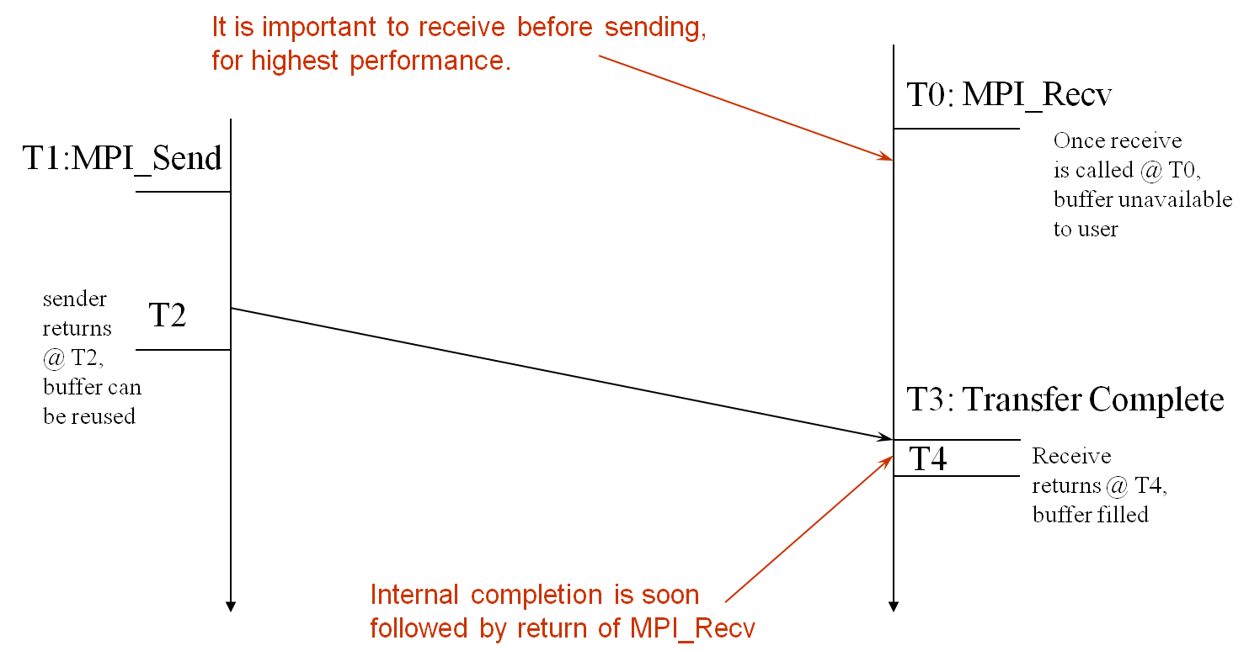
Blocking Send-Receive Diagram
time
56
Notes:
56

Slide 57
Non-Blocking Communication
Non-blocking (asynchronous) operations return (immediately) ‘‘request handles” that can be waited on and queried
MPI_ISEND(buf, count, datatype, dest, tag, comm, request)
MPI_IRECV(buf, count, datatype, src, tag, comm, request)
MPI_WAIT(request, status)
Non-blocking operations allow overlapping computation and communication
One can also test without waiting using MPI_TEST
MPI_TEST(request, flag, status)
Anywhere you use MPI_SEND or MPI_RECV, you can use the pair of MPI_ISEND/MPI_WAIT or MPI_IRECV/MPI_WAIT

Slide 58
Multiple Completions
It is sometimes desirable to wait on multiple requests:
MPI_Waitall(count, array_of_requests, array_of_statuses)
MPI_Waitany(count, array_of_requests, &index, &status)
MPI_Waitsome(incount, array_of_requests, outcount,
array_of_indices, array_of_statuses)
There are corresponding versions of TEST for each of these

Slide 59
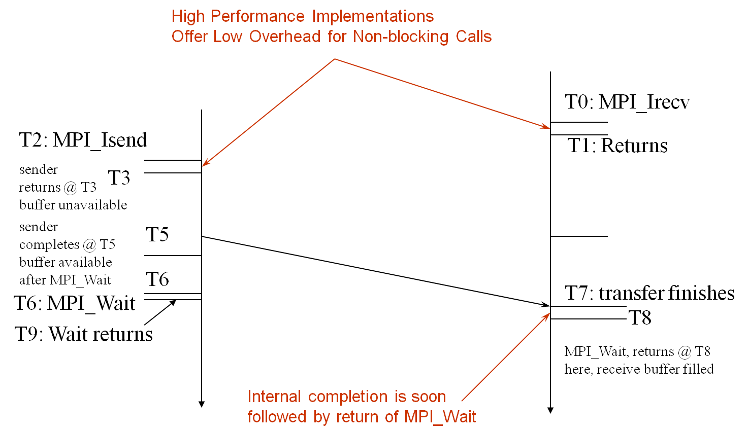
Non-Blocking Send-Receive Diagram
time
59
Notes:
59

Slide 60
Message Completion and Buffering
For a communication to succeed:
Sender must specify a valid destination rank
Receiver must specify a valid source rank (including MPI_ANY_SOURCE)
The communicator must be the same
Tags must match
Receiver’s buffer must be large enough
A send has completed when the user supplied buffer can be reused
Just because the send completes does not mean that the receive has completed
Message may be buffered by the system
Message may still be in transit
*buf = 3;
MPI_Send(buf, 1, MPI_INT …)
*buf = 4; /* OK, receiver will always
receive 3 */
*buf = 3;
MPI_Isend(buf, 1, MPI_INT …)
*buf = 4; /* Receiver may get 3, 4, or
anything else */
MPI_Wait(…);

Slide 61
A Non-Blocking communication example
P0
Blocking Communication
P1
P0
Non-blocking Communication
P1

Slide 62
A Non-Blocking communication example
int main(int argc, char ** argv)
{
[...snip...]
if (rank == 0) {
for (i=0; i< 100; i++) {
/* Compute each data element and send it out */
data[i] = compute(i);
MPI_Isend(&data[i], 1, MPI_INT, 1, 0, MPI_COMM_WORLD,
&request[i]);
}
MPI_Waitall(100, request, MPI_STATUSES_IGNORE)
}
else {
for (i = 0; i < 100; i++)
MPI_Recv(&data[i], 1, MPI_INT, 0, 0, MPI_COMM_WORLD,
MPI_STATUS_IGNORE);
}
[...snip...]
}

Slide 63
Regular Mesh Algorithms
Many scientific applications involve the solution of partial differential equations (PDEs)
Many algorithms for approximating the solution of PDEs rely on forming a set of difference equations
Finite difference, finite elements, finite volume
The exact form of the differential equations depends on the particular method
From the point of view of parallel programming for these algorithms, the operations are the same
Five-point stencil is a popular approximation solution

Slide 64
The Global Data Structure
Each circle is a mesh point
Difference equation evaluated at each point involves the four neighbors
The red “plus” is called the method’s stencil
Good numerical algorithms form a matrix equation Au=f; solving this requires computing Bv, where B is a matrix derived from A. These evaluations involve computations with the neighbors on the mesh.

Slide 65
The Global Data Structure
Each circle is a mesh point
Difference equation evaluated at each point involves the four neighbors
The red “plus” is called the method’s stencil
Good numerical algorithms form a matrix equation Au=f; solving this requires computing Bv, where B is a matrix derived from A. These evaluations involve computations with the neighbors on the mesh.
Decompose mesh into equal sized (work) pieces

Slide 66
Necessary Data Transfers

Slide 67
Necessary Data Transfers

Slide 68
The Local Data Structure
Each process has its local “patch” of the global array
“bx” and “by” are the sizes of the local array
Always allocate a halo around the patch
Array allocated of size (bx+2)x(by+2)
by
bx

Slide 69
Necessary Data Transfers
Provide access to remote data through a halo exchange (5 point stencil)

Slide 70
Understanding Performance: Unexpected Hot Spots
Basic performance analysis looks at two-party exchanges
Real applications involve many simultaneous communications
Performance problems can arise even in common grid exchange patterns
Message passing illustrates problems present even in shared memory
Blocking operations may cause unavoidable memory stalls

Slide 71
Mesh Exchange
Exchange data on a mesh
9
10
11
6
7
8
3
4
5
0
1
2
Notes:
No periodic exchange

Slide 72
Sample Code
for (i = 0; i < n_neighbors; i++) { MPI_Send(edge, len, MPI_DOUBLE, nbr[i], tag, comm); }
for (i = 0; i < n_neighbors; i++) { MPI_Recv(edge, len, MPI_DOUBLE, nbr[i], tag, comm, status); }
What is wrong with this code?

Slide 73
Deadlocks!
All of the sends may block, waiting for a matching receive (will for large enough messages)
The variation of if (has up nbr) MPI_Recv( … up … )
…
if (has down nbr) MPI_Send( … down … ) sequentializes (all except the bottom process blocks)

Slide 74
Fix 1: Use Irecv
for (i = 0; i < n_neighbors; i++) { MPI_Irecv(edge, len, MPI_DOUBLE, nbr[i], tag,
comm, requests[i]); }
for (i = 0; i < n_neighbors; i++) { MPI_Send(edge, len, MPI_DOUBLE, nbr[i], tag, comm); }
MPI_Waitall(n_neighbors, requests, statuses);
Code example: mesh-nonblocking-opt1.c
Does not perform well in practice. Why?

Slide 75
Mesh Exchange
Exchange data on a mesh
Step 1
Step 1
Step 1
Step 1
Step 1
Step 1
Step 1
Step 1
Step 1
Step 1
Step 1
Step 1

Slide 76
Mesh Exchange
Exchange data on a mesh
Step 2
Step 2
Step 2
Step 2
Step 2
Step 1
Step 2
Step 1
Step 1
Step 1
Step 1
Step 1

Slide 77
Mesh Exchange
Exchange data on a mesh
Step 2
Step 3
Step 2
Step 3
Step 3
Step 2
Step 3
Step 2
Step 2
Step 2
Step 2
Step 2

Slide 78
Mesh Exchange
Exchange data on a mesh
Step 2
Step 3
Step 2
Step 3
Step 3
Step 3
Done
Step 3
Step 3
Done
Step 3
Done

Slide 79
Mesh Exchange
Exchange data on a mesh
Done
Done
Done
Done
Step 4
Step 3
Done
Step 3
Done
Done
Done
Done

Slide 80
Mesh Exchange
Exchange data on a mesh
Done
Done
Done
Done
Done
Done
Done
Step 4
Done
Done
Done
Done

Slide 81
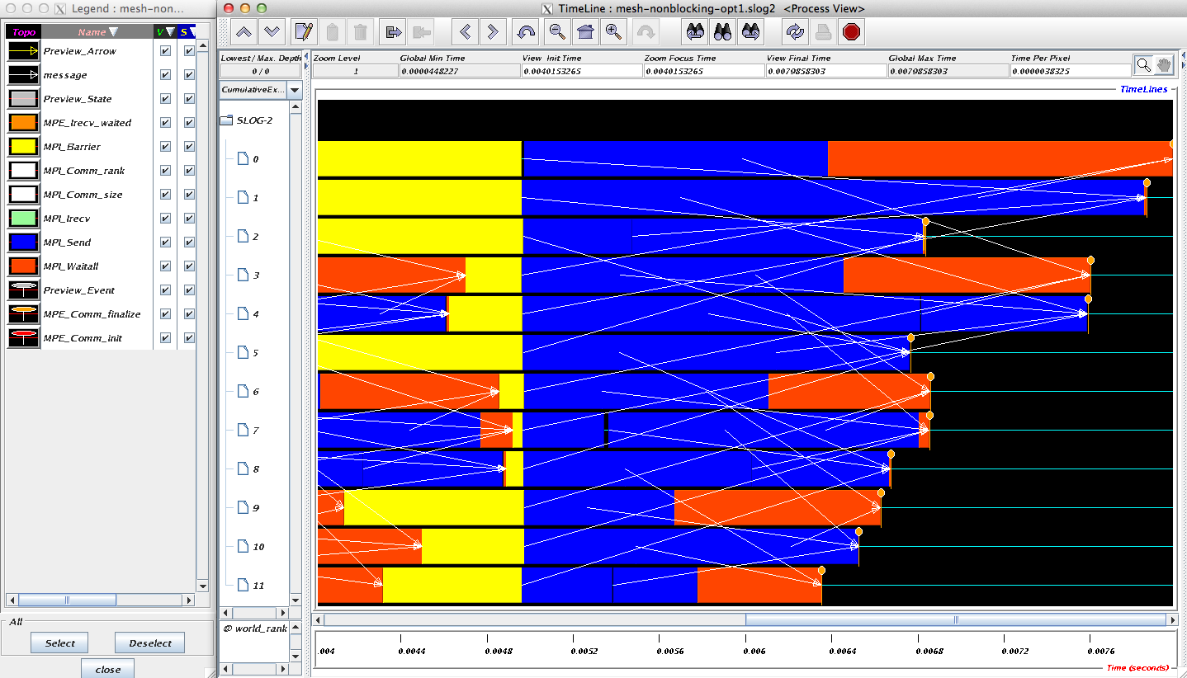
Timeline from IB Cluster

Slide 82
Fix 2: Use Isend and Irecv
for (i = 0; i < n_neighbors; i++) { MPI_Irecv(edge, len, MPI_DOUBLE, nbr[i], tag,
comm, requests[i]); }
for (i = 0; i < n_neighbors; i++) { MPI_Isend(edge, len, MPI_DOUBLE, nbr[i], tag, comm,
requests[n_neighbors + i]); }
MPI_Waitall(2 * n_neighbors, requests, statuses);

Slide 83
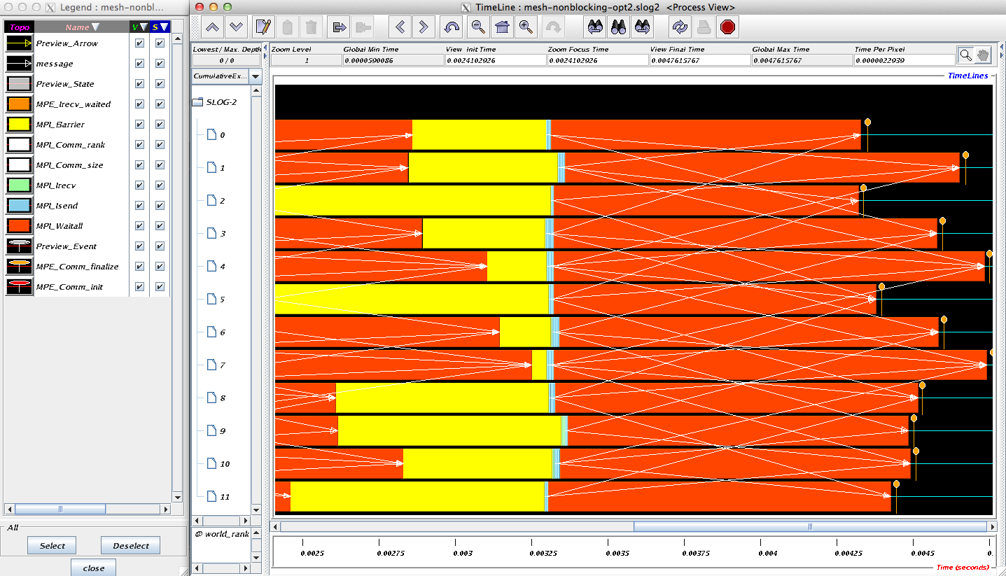
Timeline from IB Cluster
Note processes 4 and 7 are the only interior processors; these perform more communication than the other processors

Slide 84
Lesson: Defer Synchronization
Send-receive accomplishes two things:
Data transfer
Synchronization
In many cases, there is more synchronization than required
Use non-blocking operations and MPI_Waitall to defer synchronization
Tools can help out with identifying performance issues
Tau, HPCToolkit, and Scalasca are popular profiling tools

Slide 85
Code Example
stencil_mpi_nonblocking.c
Non-blocking sends and receives
Manually packing and unpacking the data
Additional communication buffers are needed

Slide 86
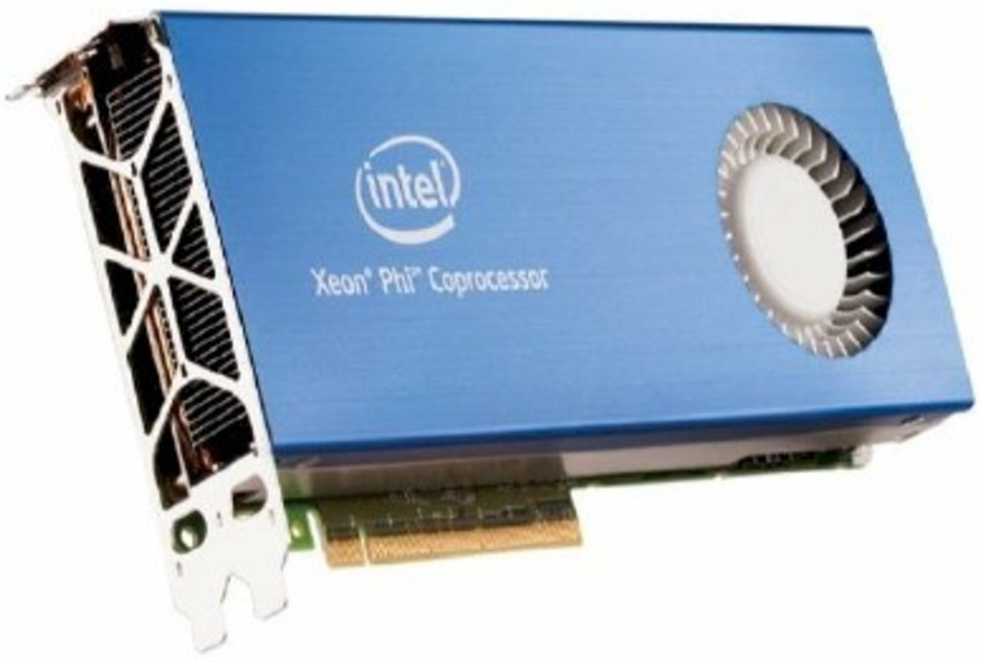
Be careful of heterogeneity

Slide 87
MPI in Heterogeneous Environments
MPI does not mandate that your program run in homogeneous environments
But many common algorithms use a homogeneity assumption, primarily for simplicity
Assuming that all processors compute at the same speed will result in your algorithm running at the speed of the slowest processor

Slide 88
GPUs vs. Intel Xeon Phi
GPU
No MPI process on a GPU (since there’s no operating system)
GPU systems are typically homogeneous
Each MPI process has one or more CPU cores + one or more GPUs
All MPI processes are “identical”
Intel Xeon Phi
GPU-like mode available (“offload mode”)
Also provides a “native mode” where you can have MPI processes running on the Intel Xeon Phi (since it has an operating system)
These systems can be heterogeneous
Some MPI processes run on the Xeon and some run on the Xeon Phi
Your algorithm might need to take such heterogeneity into account

Slide 89
What we will cover in this tutorial
What is MPI?
How to write a simple program in MPI
Running your application with MPICH
Slightly more advanced topics:
Non-blocking communication in MPI
Group (collective) communication in MPI
MPI Datatypes
Advanced topics:
Nonblocking Collectives
One-sided communication
Hybrid Programming
Network locality and Topology
What’s coming in MPI-4
Conclusions and Final Q/A

Slide 90
Introduction to Collective Operations in MPI
Collective operations are called by all processes in a communicator.
MPI_BCAST distributes data from one process (the root) to all others in a communicator.
MPI_REDUCE combines data from all processes in the communicator and returns it to one process.
In many numerical algorithms, SEND/RECV can be replaced by BCAST/REDUCE, improving both simplicity and efficiency.

Slide 91
MPI Collective Communication
Communication and computation is coordinated among a group of processes in a communicator
Tags are not used; different communicators deliver similar functionality
Non-blocking collective operations in MPI-3
Covered in the advanced tutorial (but conceptually simple)
Three classes of operations: synchronization, data movement, collective computation

Slide 92
Synchronization
MPI_BARRIER(comm)
Blocks until all processes in the group of the communicator comm call it
A process cannot get out of the barrier until all other processes have reached barrier

Slide 93
Collective Data Movement
P0
A
A
P1
Broadcast
A
P2
A
P3
A
P0
A
B
C
D
Scatter
A
P1
B
P2
C
Gather
P3
D

Slide 94
More Collective Data Movement
P0
A
A
B
C
D
P1
B
Allgather
A
B
C
D
P2
C
A
B
C
D
P3
D
A
B
C
D
P0
A0
A1
A2
A3
A0
B0
C0
D0
P1
B0
B1
B2
B3
Alltoall
A1
B1
C1
D1
P2
C0
C1
C2
C3
A2
B2
C2
D2
P3
D0
D1
D2
D3
A3
B3
C3
D3

Slide 95
Collective Computation
P0
A
f(ABCD)
P1
Reduce
B
P2
C
P3
D
P0
A
f(A)
P1
B
Scan
f(AB)
P2
C
f(ABC)
P3
D
f(ABCD)

Slide 96
MPI Collective Routines
Many Routines: MPI_ALLGATHER, MPI_ALLGATHERV, MPI_ALLREDUCE, MPI_ALLTOALL, MPI_ALLTOALLV, MPI_BCAST, MPI_GATHER, MPI_GATHERV, MPI_REDUCE, MPI_REDUCESCATTER, MPI_SCAN, MPI_SCATTER, MPI_SCATTERV
“All” versions deliver results to all participating processes
“V” versions (stands for vector) allow the chunks to have different sizes
MPI_ALLREDUCE, MPI_REDUCE, MPI_REDUCESCATTER, and MPI_SCAN take both built-in and user-defined combiner functions

Slide 97
MPI Built-in Collective Computation Operations
MPI_MAX
MPI_MIN
MPI_PROD
MPI_SUM
MPI_LAND
MPI_LOR
MPI_LXOR
MPI_BAND
MPI_BOR
MPI_BXOR
MPI_MAXLOC
MPI_MINLOC
Maximum
Minimum
Product
Sum
Logical and
Logical or
Logical exclusive or
Bitwise and
Bitwise or
Bitwise exclusive or
Maximum and location
Minimum and location

Slide 98
Defining your own Collective Operations
Create your own collective computations with: MPI_OP_CREATE(user_fn, commutes, &op); MPI_OP_FREE(&op);
user_fn(invec, inoutvec, len, datatype);
The user function should perform: inoutvec[i] = invec[i] op inoutvec[i]; for i from 0 to len-1
The user function can be non-commutative, but must be associative

Slide 99
Example: Calculating Pi
Calculating pi via numerical integration
Divide interval up into subintervals
Assign subintervals to processes
Each process calculates partial sum
Add all the partial sums together to get pi
1
1
“n” segments
Width of each segment (w) will be 1/n
Distance (d(i)) of segment “i” from the origin will be “i * w”
Height of segment “i” will be sqrt(1 – [d(i)]^2)

Slide 100
Example: PI in C
#include <mpi.h>
#include <math.h>
int main(int argc, char *argv[])
{
[...snip...]
/* Tell all processes, the number of segments you want */
MPI_Bcast(&n, 1, MPI_INT, 0, MPI_COMM_WORLD);
w = 1.0 / (double) n;
mypi = 0.0;
for (i = rank + 1; i <= n; i += size)
mypi += w * sqrt(1 – (((double) i / n) * ((double) i / n));
MPI_Reduce(&mypi, &pi, 1, MPI_DOUBLE, MPI_SUM, 0,
MPI_COMM_WORLD);
if (rank == 0)
printf("pi is approximately %.16f, Error is %.16f\n", 4 * pi,
fabs((4 * pi) - PI25DT));
[...snip...]
}

Slide 101
What we will cover in this tutorial
What is MPI?
How to write a simple program in MPI
Running your application with MPICH
Slightly more advanced topics:
Non-blocking communication in MPI
Group (collective) communication in MPI
MPI Datatypes
Advanced topics:
Nonblocking Collectives
One-sided communication
Hybrid Programming
Network locality and Topology
What’s coming in MPI-4
Conclusions and Final Q/A

Slide 102
Necessary Data Transfers
Provide access to remote data through a halo exchange (5 point stencil)

Slide 103
The Local Data Structure
Each process has its local “patch” of the global array
“bx” and “by” are the sizes of the local array
Always allocate a halo around the patch
Array allocated of size (bx+2)x(by+2)
by
bx

Slide 104
Introduction to Datatypes in MPI
Datatypes allow to (de)serialize arbitrary data layouts into a message stream
Networks provide serial channels
Same for block devices and I/O
Several constructors allow arbitrary layouts
Recursive specification possible
Declarative specification of data-layout
“what” and not “how”, leaves optimization to implementation (many unexplored possibilities!)
Choosing the right constructors is not always simple

Slide 105
Simple/Predefined Datatypes
Equivalents exist for all C, C++ and Fortran native datatypes
C int → MPI_INT
C float → MPI_FLOAT
C double → MPI_DOUBLE
C uint32_t → MPI_UINT32_T
Fortran integer → MPI_INTEGER
For more complex or user-created datatypes, MPI provides routines to represent them as well
Contiguous
Vector/Hvector
Indexed/Indexed_block/Hindexed/Hindexed_block
Struct
Some convenience types (e.g., subarray)

Slide 106
Derived Datatype Example
0
1
2
3
4
5
6
7
8
9
10
11
12
13
14
15
16
17
18
19
20
21
22
23
contig
contig
contig
indexed
vector
struct

Slide 107
MPI_Type_contiguous
MPI_Type_contiguous(int count, MPI_Datatype oldtype,
MPI_Datatype *newtype)
Contiguous array of oldtype
Should not be used as last type (can be replaced by count)
0
1
2
3
4
5
6
7
8
9
10
11
12
13
14
15
16
17
18
struct
struct
struct
contig
0
1
2
3
4
5
6
7
8
9
10
11
contig

Slide 108
MPI_Type_vector
MPI_Type_vector(int count, int blocklen, int stride,
MPI_Datatype oldtype, MPI_Datatype *newtype)
Specify strided blocks of data of oldtype
Very useful for Cartesian arrays
0
1
2
3
4
5
6
7
8
9
10
11
vector
0
1
2
3
4
5
6
7
8
9
10
11
12
13
14
15
16
17
18
19
20
struct
struct
struct
struct
vector

Slide 109
Use Datatype in Halo Exchange
contig (count=bx, MPI_DOUBLE, …) or
count with MPI_DOUBLE
by
vector (count=by, blocklen=1,
stride=bx+2, MPI_DOUBLE, …)
bx

Slide 110
MPI_Type_create_hvector
MPI_Type_create_hvector(int count, int blocklen, MPI_Aint stride,
MPI_Datatype oldtype, MPI_Datatype *newtype)
Create non-unit strided vectors
Useful for composition, e.g., vector of structs
stride = 11 bytes
0
1
2
3
4
5
6
7
8
9
10
11
12
13
14
15
16
17
18
19
struct
struct
struct
struct
stride = 3 oldtypes
hvector
vector

Slide 111
MPI_Type_create_indexed_block
MPI_Type_create_indexed_block(int count, int blocklen,
int *array_of_displacements,
MPI_Datatype oldtype, MPI_Datatype *newtype)
Pulling irregular subsets of data from a single array
dynamic codes with index lists, expensive though!
blen=2
displs={0,5,8,13,18}
0
1
2
3
4
5
6
7
8
9
10
11
12
13
14
15
16
17
18
19
20
Indexed_block

Slide 112
MPI_Type_indexed
MPI_Type_indexed(int count, int* array_of_blocklens,
int *array_of_displacements,
MPI_Datatype oldtype, MPI_Datatype *newtype)
Like indexed_block, but can have different block lengths
blen={1,1,2,1,2,1}
displs={0,3,5,9,13,17}
0
1
2
3
4
5
6
7
8
9
10
11
12
13
14
15
16
17
18
19
20
indexed

Slide 113
MPI_Type_create_struct
MPI_Type_create_struct(int count,
int* array_of_blocklens,
int *array_of_displacements,
MPI_Datatype *array_of_types,
MPI_Datatype *newtype)
Most general constructor, allows different types and arbitrary arrays (also most costly)
0
1
2
3
4
struct

Slide 114
MPI_Type_create_subarray
MPI_Type_create_subarray(int ndims, int* array_of_sizes,
int *array_of_subsizes, int *array_of_starts,
int order, MPI_Datatype oldtype, MPI_Datatype *newtype)
Convenience function for creating datatypes for array segments
Specify subarray of n-dimensional array (sizes) by start (starts) and size (subsize)
(0,0)
(0,1)
(0,2)
(0,3)
(1,0)
(1,1)
(1,2)
(1,3)
(2,0)
(2,1)
(2,2)
(2,3)
(3,0)
(3,1)
(3,2)
(3,3)

Slide 115
MPI_BOTTOM and MPI_Get_address
MPI_BOTTOM is the absolute zero address
Portability (e.g., may be non-zero in globally shared memory)
MPI_Get_address
Returns address relative to MPI_BOTTOM
Portability (do not use “&” operator in C!)
Very important to
build struct datatypes
If data spans multiple arrays
int a = 4;
float b = 9.6;
MPI_Datatype struct;
MPI_Get_address(&a, &disps[0]);
MPI_Get_address(&b, &disps[1]);
MPI_Type_create_struct(count,
blocklens[], disps,
oldtypes[], &struct);

Slide 116
Commit, Free, and Dup
Types must be committed before use
Only the ones that are used!
MPI_Type_commit may perform heavy optimizations (and will hopefully)
MPI_Type_free
Free MPI resources of datatypes
Does not affect types built from it
MPI_Type_dup
Duplicates a type
Library abstraction (composability)

Slide 117
Other DDT Functions
Pack/Unpack
Mainly for compatibility to legacy libraries
You should not be doing this yourself
Get_envelope/contents
Only for expert library developers
Libraries like MPITypes¹ make this easier
MPI_Create_resized
Change extent and size (dangerous but useful)
http://www.mcs.anl.gov/mpitypes/

Slide 118
Datatype Selection Order
Simple and effective performance model:
More parameters == slower
predefined < contig < vector < index_block < index < struct
Some (most) MPIs are inconsistent
But this rule is portable
Advice to users:
Try datatype “compression” bottom-up
W. Gropp et al.: Performance Expectations and Guidelines for MPI Derived Datatypes

Slide 119
Code Example
stencil-mpi-ddt.c
Non-blocking sends and receives
Data location specified by MPI datatypes
Manual packing of data no longer required
by
vector
bx

Slide 120
What we will cover in this tutorial
What is MPI?
How to write a simple program in MPI
Running your application with MPICH
Slightly more advanced topics:
Non-blocking communication in MPI
Group (collective) communication in MPI
MPI Datatypes
Advanced topics:
Nonblocking Collectives
One-sided communication
Hybrid Programming
Network locality and Topology
What’s coming in MPI-4
Conclusions and Final Q/A

Slide 121
Nonblocking Collective Communication
Nonblocking (send/recv) communication
Deadlock avoidance
Overlapping communication/computation
Collective communication
Collection of pre-defined optimized routines
→ Nonblocking collective communication
Combines both techniques (more than the sum of the parts ☺)
System noise/imbalance resiliency
Semantic advantages

Slide 122
Nonblocking Collective Communication
Nonblocking variants of all collectives
MPI_Ibcast(<bcast args>, MPI_Request *req);
Semantics
Function returns no matter what
No guaranteed progress (quality of implementation)
Usual completion calls (wait, test) + mixing
Out-of order completion
Restrictions
No tags, in-order matching
Send and vector buffers may not be touched during operation
MPI_Cancel not supported
No matching with blocking collectives
Notes:
in-order matching: if it is out-of-order matching, it will prohibit some optimized algorithms in implementation
Send buffers cannot be touched: same with non-blocking communications
MPI_Cancel not supported: MPI_Cancel is supported in nonblocking operations, to cancel a request handle,
because Nonblocking collective is a collective call, we need to cancel routines on all processes,
(4) No matching with blocking collectives: because blocking/nonblocking has different optimized algorithms, (blocking---communication pattern, nonblocking---overlap), we don’t want to mix them up

Slide 123
Nonblocking Collective Communication
Semantic advantages
Enable asynchronous progression (and manual)
Software pipelining
Decouple data transfer and synchronization
Noise resiliency!
Allow overlapping communicators
See also neighborhood collectives
Multiple outstanding operations at any time
Enables pipelining window

Slide 124
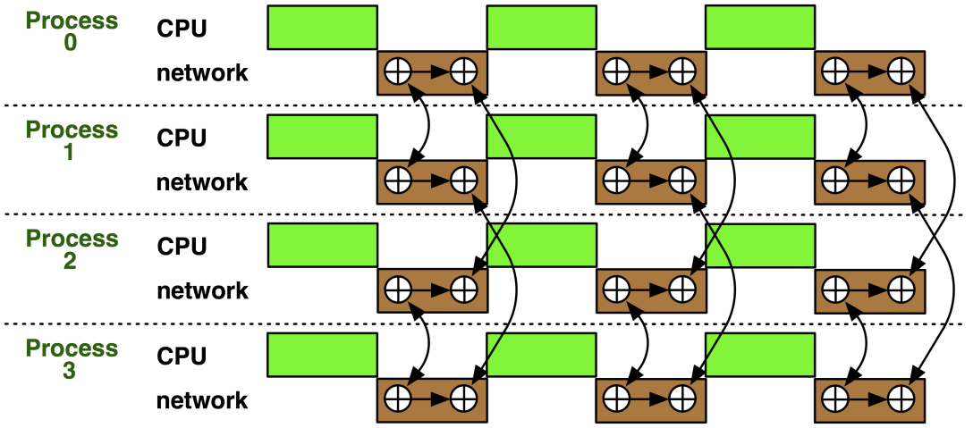
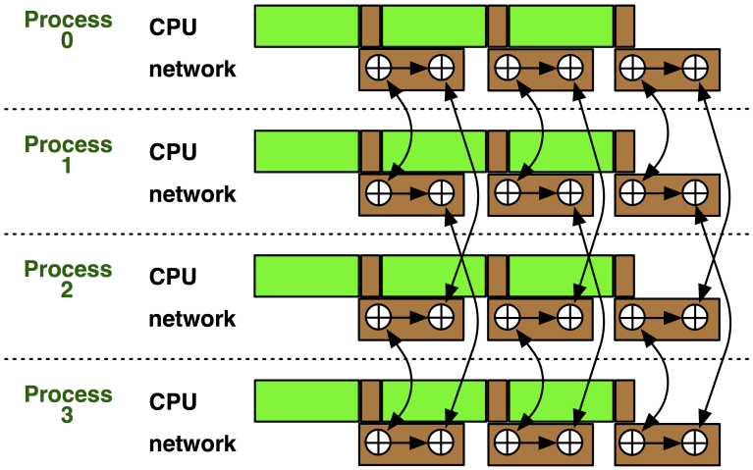
Nonblocking Collectives Overlap
Software pipelining
More complex parameters
Progression issues
Not scale-invariant

Slide 125
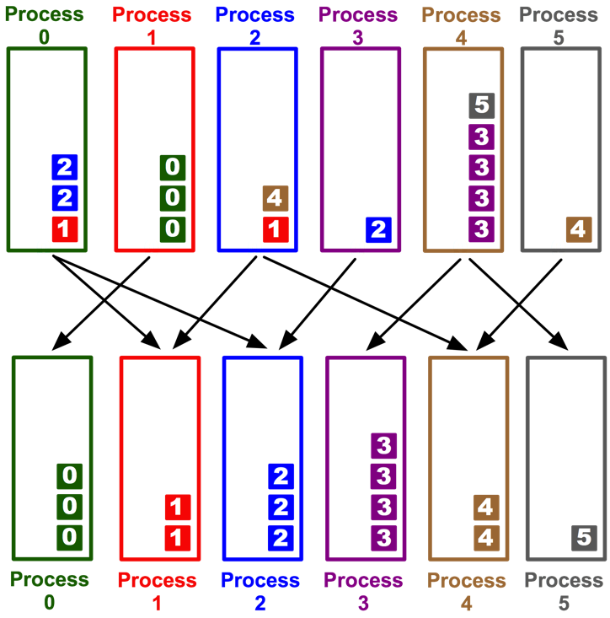
A Semantics Example: DSDE
Dynamic Sparse Data Exchange
Dynamic: comm. pattern varies across iterations
Sparse: number of neighbors is limited (O(log P))
Data exchange: only senders know neighbors
Main Problem: metadata
Determine who wants to send how much
data to me (I must post receive and reserve memory)
OR:
Use MPI semantics:
Unknown sender (MPI_ANY_SOURCE)
Unknown message size (MPI_PROBE)
Reduces problem to counting the number
of neighbors
Allow faster implementation!
Hoefler et al.: Scalable Communication Protocols for Dynamic Sparse Data Exchange

Slide 126

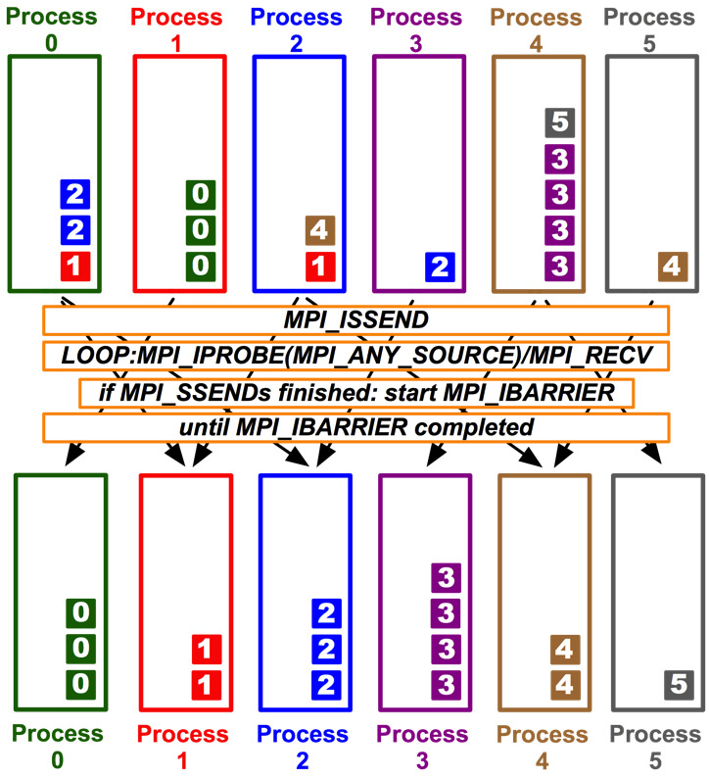
MPI_Ibarrier (NBX)
Complexity - census (barrier): ( )
Combines metadata with actual transmission
Point-to-point synchronization
Continue receiving until barrier completes
Processes start coll. synch. (barrier) when p2p phase ended
barrier = distributed marker!
Better than Alltoall, reduce-scatter!
T. Hoefler et al.: Scalable Communication Protocols for Dynamic Sparse Data Exchange

Slide 127
Parallel Breadth First Search
On a clustered Erdős-Rényi graph, weak scaling
6.75 million edges per node (filled 1 GiB)
HW barrier support is significant at large scale!
BlueGene/P – with HW barrier!
Myrinet 2000 with LibNBC
T. Hoefler et al.: Scalable Communication Protocols for Dynamic Sparse Data Exchange
Notes:
Fix
PEX – All_to_all
PCS – Reduce_scatter
NBX – ISSEND / IBARRIER

Slide 128
Parallel Fast Fourier Transform
1D FFTs in all three dimensions
Assume 1D decomposition (each process holds a set of planes)
Best way: call optimized 1D FFTs in parallel → alltoall
Red/yellow/green are the (three) different processes!
→ Alltoall

Slide 129
A Complex Example: FFT
for(int x=0; x<n/p; ++x) 1d_fft(/* x-th stencil */);
// pack data for alltoall
MPI_Alltoall(&in, n/p*n/p, cplx_t, &out, n/p*n/p, cplx_t, comm);
// unpack data from alltoall and transpose
for(int y=0; y<n/p; ++y) 1d_fft(/* y-th stencil */);
// pack data for alltoall
MPI_Alltoall(&in, n/p*n/p, cplx_t, &out, n/p*n/p, cplx_t, comm);
// unpack data from alltoall and transpose
Hoefler: Leveraging Non-blocking Collective Communication in High-performance Applications

Slide 130
Parallel Fast Fourier Transform
Data already transformed in y-direction
Notes:
- Fix alignment between slides

Slide 131
Parallel Fast Fourier Transform
Transform first y plane in z

Slide 132
Parallel Fast Fourier Transform
Start ialltoall and transform second plane

Slide 133
Parallel Fast Fourier Transform
Start ialltoall (second plane) and transform third

Slide 134
Parallel Fast Fourier Transform
Start ialltoall of third plane and …

Slide 135
Parallel Fast Fourier Transform
Finish ialltoall of first plane, start x transform

Slide 136
Parallel Fast Fourier Transform
Finish second ialltoall, transform second plane

Slide 137
Parallel Fast Fourier Transform
Transform last plane → done

Slide 138
FFT Software Pipelining
MPI_Request req[nb];
for(int b=0; b<nb; ++b) { // loop over blocks
for(int x=b*n/p/nb; x<(b+1)n/p/nb; ++x) 1d_fft(/* x-th stencil*/);
// pack b-th block of data for alltoall
MPI_Ialltoall(&in, n/p*n/p/bs, cplx_t, &out, n/p*n/p, cplx_t, comm, &req[b]);
}
MPI_Waitall(nb, req, MPI_STATUSES_IGNORE);
// modified unpack data from alltoall and transpose
for(int y=0; y<n/p; ++y) 1d_fft(/* y-th stencil */);
// pack data for alltoall
MPI_Alltoall(&in, n/p*n/p, cplx_t, &out, n/p*n/p, cplx_t, comm);
// unpack data from alltoall and transpose
Hoefler: Leveraging Non-blocking Collective Communication in High-performance Applications

Slide 139
Nonblocking And Collective Summary
Nonblocking comm does two things:
Overlap and relax synchronization
Collective comm does one thing
Specialized pre-optimized routines
Performance portability
Hopefully transparent performance
They can be composed
E.g., software pipelining

Slide 140
What we will cover in this tutorial
What is MPI?
How to write a simple program in MPI
Running your application with MPICH
Slightly more advanced topics:
Non-blocking communication in MPI
Group (collective) communication in MPI
MPI Datatypes
Advanced topics:
Nonblocking Collectives
One-sided communication
Hybrid Programming
Network locality and Topology
What’s coming in MPI-4
Conclusions and Final Q/A

Slide 141
One-sided Communication
The basic idea of one-sided communication models is to decouple data movement with process synchronization
Should be able to move data without requiring that the remote process synchronize
Each process exposes a part of its memory to other processes
Other processes can directly read from or write to this memory
Process 0
Process 1
Process 2
Process 3
Remotely
Accessible
Memory
Private
Memory
Remotely
Accessible
Memory
Private
Memory
Remotely
Accessible Memory
Private
Memory
Remotely
Accessible Memory
Global Address Space
Private
Memory
Private
Memory
Private
Memory
Private
Memory
Private
Memory

Slide 142
Two-sided Communication Example
Memory
Processor
Processor
Memory
Memory
Segment
Memory
Segment
Memory
Segment
Memory
Segment
Memory
Segment
Send
Recv
Send
Recv
MPI implementation
MPI implementation

Slide 143
One-sided Communication Example
Memory
Processor
Processor
Memory
Memory
Segment
Memory
Segment
Memory
Segment
Memory
Segment
Send
Recv
Send
Recv
MPI implementation
MPI implementation

Slide 144
Comparing One-sided and Two-sided Programming
Process 0
Process 1
SEND(data)
DELAY
Even the sending process is delayed
RECV(data)
Process 0
Process 1
PUT(data)
DELAY
Delay in process 1 does not affect process 0
GET(data)

Slide 145
What we need to know in MPI RMA
How to create remote accessible memory?
Reading, Writing and Updating remote memory
Data Synchronization
Memory Model

Slide 146
Creating Public Memory
Any memory used by a process is, by default, only locally accessible
X = malloc(100);
Once the memory is allocated, the user has to make an explicit MPI call to declare a memory region as remotely accessible
MPI terminology for remotely accessible memory is a “window”
A group of processes collectively create a “window”
Once a memory region is declared as remotely accessible, all processes in the window can read/write data to this memory without explicitly synchronizing with the target process
Process 0
Process 1
Process 2
Process 3
window
Private
Memory
window
Private
Memory
window
Private
Memory
window
Private
Memory
Private
Memory
Private
Memory
Private
Memory
Private
Memory

Slide 147
Window creation models
Four models exist
MPI_WIN_ALLOCATE
You want to create a buffer and directly make it remotely accessible
MPI_WIN_CREATE
You already have an allocated buffer that you would like to make remotely accessible
MPI_WIN_CREATE_DYNAMIC
You don’t have a buffer yet, but will have one in the future
You may want to dynamically add/remove buffers to/from the window
MPI_WIN_ALLOCATE_SHARED
You want multiple processes on the same node share a buffer

Slide 148
MPI_WIN_ALLOCATE
MPI_Win_allocate(MPI_Aint size, int disp_unit,
MPI_Info info, MPI_Comm comm, void *baseptr,
MPI_Win *win)
Create a remotely accessible memory region in an RMA window
Only data exposed in a window can be accessed with RMA ops.
Arguments:
size - size of local data in bytes (nonnegative integer)
disp_unit - local unit size for displacements, in bytes (positive integer)
info - info argument (handle)
comm - communicator (handle)
baseptr - pointer to exposed local data
win - window (handle)

Slide 149
Example with MPI_WIN_ALLOCATE
int main(int argc, char ** argv)
{
int *a; MPI_Win win;
MPI_Init(&argc, &argv);
/* collectively create remote accessible memory in a window */
MPI_Win_allocate(1000*sizeof(int), sizeof(int), MPI_INFO_NULL,
MPI_COMM_WORLD, &a, &win);
/* Array ‘a’ is now accessible from all processes in
* MPI_COMM_WORLD */
MPI_Win_free(&win);
MPI_Finalize(); return 0;
}

Slide 150
MPI_WIN_CREATE
MPI_Win_create(void *base, MPI_Aint size, int disp_unit, MPI_Info info, MPI_Comm comm, MPI_Win *win)
Expose a region of memory in an RMA window
Only data exposed in a window can be accessed with RMA ops.
Arguments:
base - pointer to local data to expose
size - size of local data in bytes (nonnegative integer)
disp_unit - local unit size for displacements, in bytes (positive integer)
info - info argument (handle)
comm - communicator (handle)
win - window (handle)

Slide 151
Example with MPI_WIN_CREATE
int main(int argc, char ** argv)
{
int *a; MPI_Win win;
MPI_Init(&argc, &argv);
/* create private memory */
MPI_Alloc_mem(1000*sizeof(int), MPI_INFO_NULL, &a);
/* use private memory like you normally would */
a[0] = 1; a[1] = 2;
/* collectively declare memory as remotely accessible */
MPI_Win_create(a, 1000*sizeof(int), sizeof(int),
MPI_INFO_NULL, MPI_COMM_WORLD, &win);
/* Array ‘a’ is now accessibly by all processes in
* MPI_COMM_WORLD */
MPI_Win_free(&win);
MPI_Free_mem(a);
MPI_Finalize(); return 0;
}

Slide 152
MPI_WIN_CREATE_DYNAMIC
MPI_Win_create_dynamic(MPI_Info info, MPI_Comm comm,
MPI_Win *win)
Create an RMA window, to which data can later be attached
Only data exposed in a window can be accessed with RMA ops
Initially “empty”
Application can dynamically attach/detach memory to this window by calling MPI_Win_attach/detach
Application can access data on this window only after a memory region has been attached
Window origin is MPI_BOTTOM
Displacements are segment addresses relative to MPI_BOTTOM
Must tell others the displacement after calling attach

Slide 153
Example with MPI_WIN_CREATE_DYNAMIC
int main(int argc, char ** argv)
{
int *a; MPI_Win win;
MPI_Init(&argc, &argv);
MPI_Win_create_dynamic(MPI_INFO_NULL, MPI_COMM_WORLD, &win);
/* create private memory */
a = (int *) malloc(1000 * sizeof(int));
/* use private memory like you normally would */
a[0] = 1; a[1] = 2;
/* locally declare memory as remotely accessible */
MPI_Win_attach(win, a, 1000*sizeof(int));
/* Array ‘a’ is now accessible from all processes */
/* undeclare remotely accessible memory */
MPI_Win_detach(win, a); free(a);
MPI_Win_free(&win);
MPI_Finalize(); return 0;
}

Slide 154
Data movement
MPI provides ability to read, write and atomically modify data in remotely accessible memory regions
MPI_PUT
MPI_GET
MPI_ACCUMULATE (atomic)
MPI_GET_ACCUMULATE (atomic)
MPI_COMPARE_AND_SWAP (atomic)
MPI_FETCH_AND_OP (atomic)

Slide 155
Data movement: Put
MPI_Put(void *origin_addr, int origin_count,
MPI_Datatype origin_dtype, int target_rank,
MPI_Aint target_disp, int target_count,
MPI_Datatype target_dtype, MPI_Win win)
Move data from origin, to target
Separate data description triples for origin and target
Remotely Accessible Memory
Private Memory
Origin
Target

Slide 156
Data movement: Get
MPI_Get(void *origin_addr, int origin_count,
MPI_Datatype origin_dtype, int target_rank,
MPI_Aint target_disp, int target_count,
MPI_Datatype target_dtype, MPI_Win win)
Move data to origin, from target
Separate data description triples for origin and target
Remotely Accessible Memory
Private Memory
Origin
Target

Slide 157
Atomic Data Aggregation: Accumulate
MPI_Accumulate(void *origin_addr, int origin_count,
MPI_Datatype origin_dtype, int target_rank,
MPI_Aint target_disp, int target_count,
MPI_Datatype target_dtype, MPI_Op op, MPI_Win win)
Atomic update operation, similar to a put
Reduces origin and target data into target buffer using op argument as combiner
Op = MPI_SUM, MPI_PROD, MPI_OR, MPI_REPLACE, MPI_NO_OP, …
Predefined ops only, no user-defined operations
Different data layouts between target/origin OK
Basic type elements must match
Op = MPI_REPLACE
Implements f(a,b)=b
Atomic PUT
Remotely Accessible Memory
+=
Private Memory
Origin
Target

Slide 158
Atomic Data Aggregation: Get Accumulate
MPI_Get_accumulate(void *origin_addr, int origin_count,
MPI_Datatype origin_dtype, void *result_addr,
int result_count, MPI_Datatype result_dtype,
int target_rank, MPI_Aint target_disp,
int target_count, MPI_Datatype target_dype,
MPI_Op op, MPI_Win win)
Atomic read-modify-write
Op = MPI_SUM, MPI_PROD, MPI_OR, MPI_REPLACE, MPI_NO_OP, …
Predefined ops only
Result stored in target buffer
Original data stored in result buf
Different data layouts between target/origin OK
Basic type elements must match
Atomic get with MPI_NO_OP
Atomic swap with MPI_REPLACE
Remotely Accessible Memory
+=
Private Memory
Origin
Target

Slide 159
Atomic Data Aggregation: CAS and FOP
MPI_Fetch_and_op(void *origin_addr, void *result_addr,
MPI_Datatype dtype, int target_rank,
MPI_Aint target_disp, MPI_Op op, MPI_Win win)
MPI_Compare_and_swap(void *origin_addr, void *compare_addr,
void *result_addr, MPI_Datatype dtype, int target_rank,
MPI_Aint target_disp, MPI_Win win)
FOP: Simpler version of MPI_Get_accumulate
All buffers share a single predefined datatype
No count argument (it’s always 1)
Simpler interface allows hardware optimization
CAS: Atomic swap if target value is equal to compare value

Slide 160
Ordering of Operations in MPI RMA
No guaranteed ordering for Put/Get operations
Result of concurrent Puts to the same location undefined
Result of Get concurrent Put/Accumulate undefined
Can be garbage in both cases
Result of concurrent accumulate operations to the same location are defined according to the order in which the occurred
Atomic put: Accumulate with op = MPI_REPLACE
Atomic get: Get_accumulate with op = MPI_NO_OP
Accumulate operations from a given process are ordered by default
User can tell the MPI implementation that (s)he does not require ordering as optimization hint
You can ask for only the needed orderings: RAW (read-after-write), WAR, RAR, or WAW

Slide 161
Examples with operation ordering
Process 0
Process 1
PUT(x=1, P1)
x = 0
1. Concurrent Puts: undefined
PUT(x=2, P1)
x = 2
x = 1
PUT(x=2, P1)
2. Concurrent Get and Put/Accumulates: undefined
x = 1
GET(y, x, P1)
y=1
x = 2
GET_ACC (y, x+=2, P1)
x = 2
ACC (x+=1, P1)
3. Concurrent Accumulate operations to the same location : ordering is guaranteed
x += 2
y=2
x += 1

Slide 162
RMA Synchronization Models
RMA data access model
When is a process allowed to read/write remotely accessible memory?
When is data written by process X is available for process Y to read?
RMA synchronization models define these semantics
Three synchronization models provided by MPI:
Fence (active target)
Post-start-complete-wait (generalized active target)
Lock/Unlock (passive target)
Data accesses occur within “epochs”
Access epochs: contain a set of operations issued by an origin process
Exposure epochs: enable remote processes to update a target’s window
Epochs define ordering and completion semantics
Synchronization models provide mechanisms for establishing epochs
E.g., starting, ending, and synchronizing epochs

Slide 163
Fence: Active Target Synchronization
MPI_Win_fence(int assert, MPI_Win win)
Collective synchronization model
Starts and ends access and exposure epochs on all processes in the window
All processes in group of “win” do an MPI_WIN_FENCE to open an epoch
Everyone can issue PUT/GET operations to read/write data
Everyone does an MPI_WIN_FENCE to close the epoch
All operations complete at the second fence synchronization
P0
P1
P2
Fence
Fence

Slide 164
Implementing Stencil Computation with RMA Fence
RMA window
PUT
Target buffers
Origin buffers
PUT
PUT
PUT

Slide 165
Code Example
stencil_mpi_ddt_rma.c
Use MPI_PUTs to move data, explicit receives are not needed
Data location specified by MPI datatypes
Manual packing of data no longer required

Slide 166
PSCW: Generalized Active Target Synchronization
MPI_Win_post/start(MPI_Group grp, int assert, MPI_Win win)
MPI_Win_complete/wait(MPI_Win win)
Like FENCE, but origin and target specify who they communicate with
Target: Exposure epoch
Opened with MPI_Win_post
Closed by MPI_Win_wait
Origin: Access epoch
Opened by MPI_Win_start
Closed by MPI_Win_complete
All synchronization operations may block, to enforce P-S/C-W ordering
Processes can be both origins and targets
Target
Origin
Post
Start
Complete
Wait

Slide 167
Lock/Unlock: Passive Target Synchronization
Active Target Mode
Passive Target Mode
Post
Lock
Start
Wait
Complete
Unlock
Passive mode: One-sided, asynchronous communication
Target does not participate in communication operation
Shared memory-like model

Slide 168
Passive Target Synchronization
MPI_Win_lock(int locktype, int rank, int assert, MPI_Win win)
MPI_Win_unlock(int rank, MPI_Win win)
MPI_Win_flush/flush_local(int rank, MPI_Win win)
Lock/Unlock: Begin/end passive mode epoch
Target process does not make a corresponding MPI call
Can initiate multiple passive target epochs to different processes
Concurrent epochs to same process not allowed (affects threads)
Lock type
SHARED: Other processes using shared can access concurrently
EXCLUSIVE: No other processes can access concurrently
Flush: Remotely complete RMA operations to the target process
After completion, data can be read by target process or a different process
Flush_local: Locally complete RMA operations to the target process

Slide 169
Advanced Passive Target Synchronization
MPI_Win_lock_all(int assert, MPI_Win win)
MPI_Win_unlock_all(MPI_Win win)
MPI_Win_flush_all/flush_local_all(MPI_Win win)
Lock_all: Shared lock, passive target epoch to all other processes
Expected usage is long-lived: lock_all, put/get, flush, …, unlock_all
Flush_all – remotely complete RMA operations to all processes
Flush_local_all – locally complete RMA operations to all processes

Slide 170
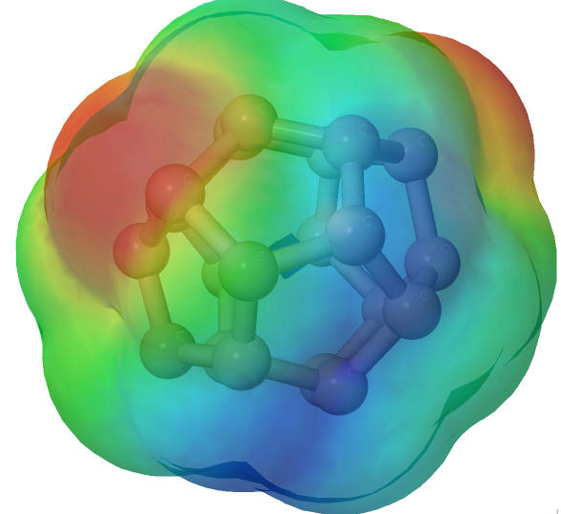
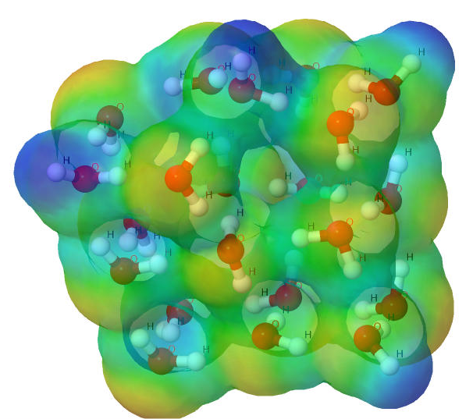
NWChem ^{[1]}
High performance computational chemistry application suite
Quantum level simulation of molecular systems
Very expensive in computation and data movement, so is used for small systems
Larger systems use molecular level simulations
Composed of many simulation capabilities
Molecular Electronic Structure
Quantum Mechanics/Molecular Mechanics
Pseudo potential Plane-Wave Electronic Structure
Molecular Dynamics
Very large code base
4M LOC; Total investment of ~1B $ to date
Carbon C₂₀
Water (H₂O)²¹
[1] M. Valiev, E.J. Bylaska, N. Govind, K. Kowalski, T.P. Straatsma, H.J.J. van Dam, D. Wang, J. Nieplocha, E. Apra, T.L. Windus, W.A. de Jong, "NWChem: a comprehensive and scalable open-source solution for large scale molecular simulations" Comput. Phys. Commun. 181, 1477 (2010)

Slide 171
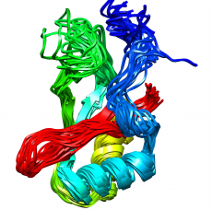
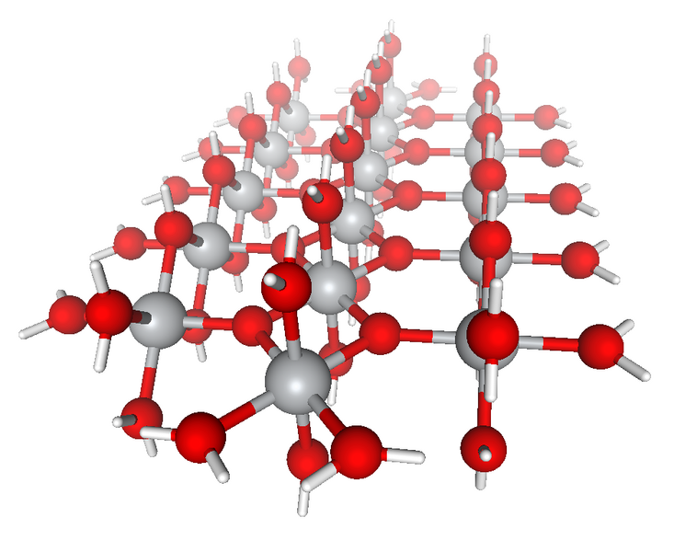
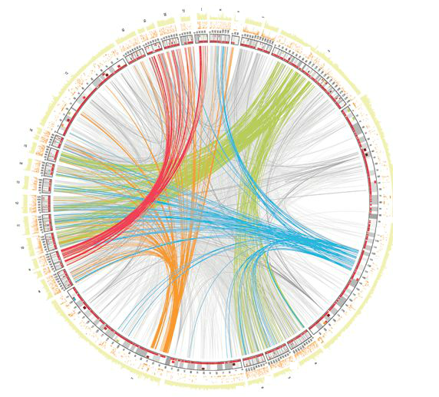



NWChem Communication Runtime
Abstractions for distributed arrays
Global Address Space
Applications
Physically distributed to different processes
Global Arrays ^{[2]}
Hidden from user
ARMCI : Communication interface for RMA^{[3]}
Irregularly access large amount of remote memory regions
ARMCI native ports
…
ARMCI-MPI
IB
DMMAP
MPI RMA
[2] http://hpc.pnl.gov/globalarrays
[3] http://hpc.pnl.gov/armci

Slide 172
Get-Compute-Update
Typical Get-Compute-Update mode in GA programming
All of the blocks are non-contiguous data
Pseudo code
for i in I blocks:
for j in J blocks:
for k in K blocks:
GET block a from A
GET block b from B
c += a * b /*computing*/
end do
ACC block c to C
NXTASK
end do
end do
GET block a
GET
block b
ACCUMULATE
block c
Perform DGEMM in local buffer
Mock figure showing 2D DGEMM with block-sparse computations. In reality, NWChem uses 6D tensors.

Slide 173
Code Example
ga_mpi_ddt_rma.c
Only synchronization from origin processes, no synchronization from target processes

Slide 174
Which synchronization mode should I use, when?
RMA communication has low overheads versus send/recv
Two-sided: Matching, queuing, buffering, unexpected receives, etc…
One-sided: No matching, no buffering, always ready to receive
Utilize RDMA provided by high-speed interconnects (e.g. InfiniBand)
Active mode: bulk synchronization
E.g. ghost cell exchange
Passive mode: asynchronous data movement
Useful when dataset is large, requiring memory of multiple nodes
Also, when data access and synchronization pattern is dynamic
Common use case: distributed, shared arrays
Passive target locking mode
Lock/unlock – Useful when exclusive epochs are needed
Lock_all/unlock_all – Useful when only shared epochs are needed

Slide 175
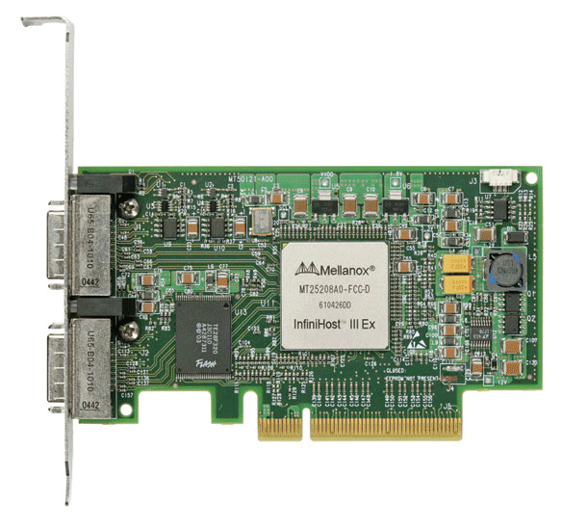
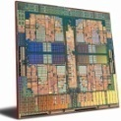
MPI RMA Memory Model
MPI-3 provides two memory models: separate and unified
MPI-2: Separate Model
Logical public and private copies
MPI provides software coherence between window copies
Extremely portable, to systems that don’t provide hardware coherence
MPI-3: New Unified Model
Single copy of the window
System must provide coherence
Superset of separate semantics
E.g. allows concurrent local/remote access
Provides access to full performance potential of hardware
Public
Copy
Unified
Copy
Private
Copy

Slide 176
MPI RMA Memory Model (separate windows)
Same source
Same epoch
Diff. Sources
X
Public
Copy
X
Private
Copy
load
store
store
Very portable, compatible with non-coherent memory systems
Limits concurrent accesses to enable software coherence

Slide 177
MPI RMA Memory Model (unified windows)
Same source
Same epoch
Diff. Sources
X
Unified
Copy
load
store
store
Allows concurrent local/remote accesses
Concurrent, conflicting operations are allowed (not invalid)
Outcome is not defined by MPI (defined by the hardware)
Can enable better performance by reducing synchronization

Slide 178
MPI RMA Operation Compatibility (Separate)
 | Load | Store | Get | Put | Acc
Load | OVL+NOVL | OVL+NOVL | OVL+NOVL | NOVL | NOVL
Store | OVL+NOVL | OVL+NOVL | NOVL | X | X
Get | OVL+NOVL | NOVL | OVL+NOVL | NOVL | NOVL
Put | NOVL | X | NOVL | NOVL | NOVL
Acc | NOVL | X | NOVL | NOVL | OVL+NOVL
This matrix shows the compatibility of MPI-RMA operations when two or more processes access a window at the same target concurrently.
OVL – Overlapping operations permitted
NOVL – Nonoverlapping operations permitted
X – Combining these operations is OK, but data might be garbage

Slide 179
MPI RMA Operation Compatibility (Unified)
 | Load | Store | Get | Put | Acc
Load | OVL+NOVL | OVL+NOVL | OVL+NOVL | NOVL | NOVL
Store | OVL+NOVL | OVL+NOVL | NOVL | NOVL | NOVL
Get | OVL+NOVL | NOVL | OVL+NOVL | NOVL | NOVL
Put | NOVL | NOVL | NOVL | NOVL | NOVL
Acc | NOVL | NOVL | NOVL | NOVL | OVL+NOVL
This matrix shows the compatibility of MPI-RMA operations when two or more processes access a window at the same target concurrently.
OVL – Overlapping operations permitted
NOVL – Nonoverlapping operations permitted

Slide 180
What we will cover in this tutorial
What is MPI?
How to write a simple program in MPI
Running your application with MPICH
Slightly more advanced topics:
Non-blocking communication in MPI
Group (collective) communication in MPI
MPI Datatypes
Advanced topics:
Nonblocking Collectives
One-sided communication
Hybrid Programming
Network locality and Topology
What’s coming in MPI-4
Conclusions and Final Q/A

Slide 181
MPI and Threads
MPI describes parallelism between processes (with separate address spaces)
Thread parallelism provides a shared-memory model within a process
OpenMP and Pthreads are common models
OpenMP provides convenient features for loop-level parallelism. Threads are created and managed by the compiler, based on user directives.
Pthreads provide more complex and dynamic approaches. Threads are created and managed explicitly by the user.

Slide 182
Programming for Multicore
Common options for programming multicore clusters
All MPI
MPI between processes both within a node and across nodes
MPI internally uses shared memory to communicate within a node
MPI + OpenMP
Use OpenMP within a node and MPI across nodes
MPI + Pthreads
Use Pthreads within a node and MPI across nodes
The latter two approaches are known as “hybrid programming”

Slide 183
Hybrid Programming with MPI+Threads
In MPI-only programming, each MPI process has a single program counter
In MPI+threads hybrid programming, there can be multiple threads executing simultaneously
All threads share all MPI objects (communicators, requests)
The MPI implementation might need to take precautions to make sure the state of the MPI stack is consistent
MPI-only Programming
Rank 0
Rank 1
MPI+Threads Hybrid Programming
Rank 0
Rank 1
Notes:
There’s always at least one thread in the process.

Slide 184
MPI’s Four Levels of Thread Safety
MPI defines four levels of thread safety -- these are commitments the application makes to the MPI
MPI_THREAD_SINGLE: only one thread exists in the application
MPI_THREAD_FUNNELED: multithreaded, but only the main thread makes MPI calls (the one that called MPI_Init_thread)
MPI_THREAD_SERIALIZED: multithreaded, but only one thread at a time makes MPI calls
MPI_THREAD_MULTIPLE: multithreaded and any thread can make MPI calls at any time (with some restrictions to avoid races – see next slide)
Thread levels are in increasing order
If an application works in FUNNELED mode, it can work in SERIALIZED
MPI defines an alternative to MPI_Init
MPI_Init_thread(requested, provided)
Application specifies level it needs; MPI implementation returns level it supports

Slide 185
MPI_THREAD_SINGLE
There are no additional user threads in the system
E.g., there are no OpenMP parallel regions
int main(int argc, char ** argv)
{
int buf[100];
MPI_Init(&argc, &argv);
MPI_Comm_rank(MPI_COMM_WORLD, &rank);
for (i = 0; i < 100; i++)
compute(buf[i]);
/* Do MPI stuff */
MPI_Finalize();
return 0;
}

Slide 186
MPI_THREAD_FUNNELED
All MPI calls are made by the master thread
Outside the OpenMP parallel regions
In OpenMP master regions
int main(int argc, char ** argv)
{
int buf[100], provided;
MPI_Init_thread(&argc, &argv, MPI_THREAD_FUNNELED, &provided); if (provided < MPI_THREAD_FUNNELED) MPI_Abort(MPI_COMM_WORLD,1);
#pragma omp parallel for
for (i = 0; i < 100; i++)
compute(buf[i]);
/* Do MPI stuff */
MPI_Finalize();
return 0;
}
MPI Process
COMP.
MPI COMM.
COMP.

Slide 187
MPI_THREAD_SERIALIZED
Only one thread can make MPI calls at a time
Protected by OpenMP critical regions
int main(int argc, char ** argv)
{
int buf[100], provided;
MPI_Init_thread(&argc, &argv, MPI_THREAD_SERIALIZED, &provided);
if (provided < MPI_THREAD_SERIALIZED) MPI_Abort(MPI_COMM_WORLD,1);
#pragma omp parallel for
for (i = 0; i < 100; i++) {
compute(buf[i]);
#pragma omp critical
/* Do MPI stuff */
}
MPI_Finalize();
return 0;
}
MPI Process
COMP.
MPI COMM.
COMP.

Slide 188
MPI_THREAD_MULTIPLE
Any thread can make MPI calls any time (restrictions apply)
int main(int argc, char ** argv)
{
int buf[100], provided;
MPI_Init_thread(&argc, &argv, MPI_THREAD_MULTIPLE, &provided);
if (provided < MPI_THREAD_MULTIPLE) MPI_Abort(MPI_COMM_WORLD,1);
#pragma omp parallel for
for (i = 0; i < 100; i++) {
compute(buf[i]);
/* Do MPI stuff */
}
MPI_Finalize();
return 0;
}
MPI Process
COMP.
MPI COMM.
COMP.

Slide 189
Threads and MPI
An implementation is not required to support levels higher than MPI_THREAD_SINGLE; that is, an implementation is not required to be thread safe
A fully thread-safe implementation will support MPI_THREAD_MULTIPLE
A program that calls MPI_Init (instead of MPI_Init_thread) should assume that only MPI_THREAD_SINGLE is supported
MPI Standard mandates MPI_THREAD_SINGLE for MPI_Init
A threaded MPI program that does not call MPI_Init_thread is an incorrect program (common user error we see)
Notes:
189

Slide 190
Implementing Stencil Computation using MPI_THREAD_FUNNELED

Slide 191
Code Examples
stencil_mpi_ddt_funneled.c
Parallelize computation (OpenMP parallel for)
Main thread does all communication

Slide 192
Specification of MPI_THREAD_MULTIPLE
Ordering: When multiple threads make MPI calls concurrently, the outcome will be as if the calls executed sequentially in some (any) order
Ordering is maintained within each thread
User must ensure that collective operations on the same communicator, window, or file handle are correctly ordered among threads
E.g., cannot call a broadcast on one thread and a reduce on another thread on the same communicator
It is the user's responsibility to prevent races when threads in the same application post conflicting MPI calls
E.g., accessing an info object from one thread and freeing it from another thread
Blocking: Blocking MPI calls will block only the calling thread and will not prevent other threads from running or executing MPI functions
Notes:
192

Slide 193
Ordering in MPI_THREAD_MULTIPLE: Incorrect Example with Collectives
Process 0
MPI_Bcast(comm)
MPI_Barrier(comm)
Process 1
MPI_Bcast(comm)
MPI_Barrier(comm)
Thread 1
Thread 2
P0 and P1 can have different orderings of Bcast and Barrier
Here the user must use some kind of synchronization to ensure that either thread 1 or thread 2 gets scheduled first on both processes
Otherwise a broadcast may get matched with a barrier on the same communicator, which is not allowed in MPI

Slide 194
Ordering in MPI_THREAD_MULTIPLE: Incorrect Example with RMA
int main(int argc, char ** argv)
{
/* Initialize MPI and RMA window */
#pragma omp parallel for
for (i = 0; i < 100; i++) {
target = rand();
MPI_Win_lock(MPI_LOCK_EXCLUSIVE, target, 0, win);
MPI_Put(..., win);
MPI_Win_unlock(target, win);
}
/* Free MPI and RMA window */
return 0;
}
Different threads can lock the same process causing multiple locks to the same target before the first lock is unlocked

Slide 195
Ordering in MPI_THREAD_MULTIPLE: Incorrect Example with Object Management
Process 0
MPI_Bcast(comm)
MPI_Comm_free(comm)
Process 1
MPI_Bcast(comm)
MPI_Comm_free(comm)
Thread 1
Thread 2
The user has to make sure that one thread is not using an object while another thread is freeing it
This is essentially an ordering issue; the object might get freed before it is used

Slide 196
Blocking Calls in MPI_THREAD_MULTIPLE: Correct Example
Process 0
MPI_Recv(src=1)
MPI_Send(dst=1)
Process 1
MPI_Recv(src=0)
MPI_Send(dst=0)
Thread 1
Thread 2
An implementation must ensure that the above example never deadlocks for any ordering of thread execution
That means the implementation cannot simply acquire a thread lock and block within an MPI function. It must release the lock to allow other threads to make progress.

Slide 197
Implementing Stencil Computation using MPI_THREAD_MULTIPLE

Slide 198
Code Examples
stencil_mpi_ddt_multiple.c
Divide the process memory among OpenMP threads
Each thread responsible for communication and computation

Slide 199
The Current Situation
All MPI implementations support MPI_THREAD_SINGLE (duh).
They probably support MPI_THREAD_FUNNELED even if they don’t admit it.
Does require thread-safe malloc
Probably OK in OpenMP programs
Many (but not all) implementations support THREAD_MULTIPLE
Hard to implement efficiently though (lock granularity issue)
“Easy” OpenMP programs (loops parallelized with OpenMP, communication in between loops) only need FUNNELED
So don’t need “thread-safe” MPI for many hybrid programs
But watch out for Amdahl’s Law!

Slide 200
Performance with MPI_THREAD_MULTIPLE
Thread safety does not come for free
The implementation must protect certain data structures or parts of code with mutexes or critical sections
To measure the performance impact, we ran tests to measure communication performance when using multiple threads versus multiple processes
For results, see Thakur/Gropp paper: “Test Suite for Evaluating Performance of Multithreaded MPI Communication,” Parallel Computing, 2009

Slide 201
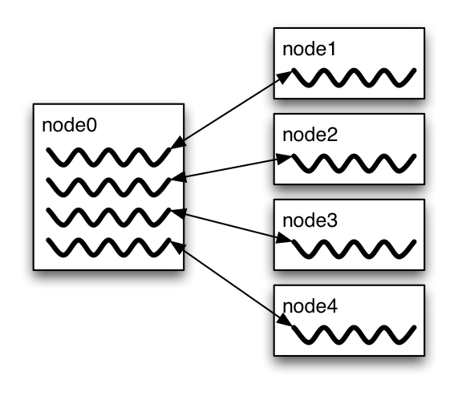
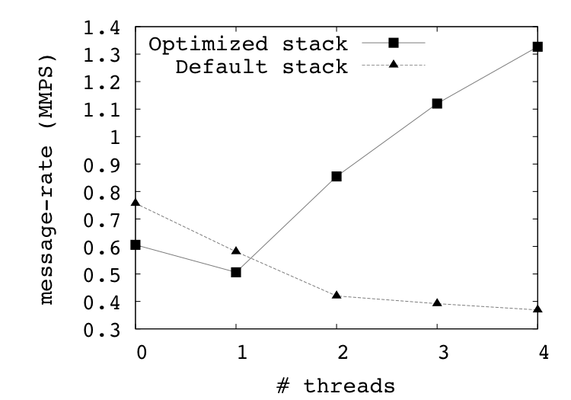
Message Rate Results on BG/P
Message Rate Benchmark
“Enabling Concurrent Multithreaded MPI Communication on Multicore Petascale Systems” EuroMPI 2010

Slide 202
Why is it hard to optimize MPI_THREAD_MULTIPLE
MPI internally maintains several resources
Because of MPI semantics, it is required that all threads have access to some of the data structures
E.g., thread 1 can post an Irecv, and thread 2 can wait for its completion – thus the request queue has to be shared between both threads
Since multiple threads are accessing this shared queue, it needs to be locked – adds a lot of overhead

Slide 203
Hybrid Programming: Correctness Requirements
Hybrid programming with MPI+threads does not do much to reduce the complexity of thread programming
Your application still has to be a correct multi-threaded application
On top of that, you also need to make sure you are correctly following MPI semantics
Many commercial debuggers offer support for debugging hybrid MPI+threads applications (mostly for MPI+Pthreads and MPI+OpenMP)

Slide 204
An Example we encountered
We received a bug report about a very simple multithreaded MPI program that hangs
Run with 2 processes
Each process has 2 threads
Both threads communicate with threads on the other process as shown in the next slide
We spent several hours trying to debug MPICH before discovering that the bug is actually in the user’s program ☹

Slide 205
2 Proceses, 2 Threads, Each Thread Executes this Code
for (j = 0; j < 2; j++) {
if (rank == 1) {
for (i = 0; i < 2; i++)
MPI_Send(NULL, 0, MPI_CHAR, 0, 0, MPI_COMM_WORLD);
for (i = 0; i < 2; i++)
MPI_Recv(NULL, 0, MPI_CHAR, 0, 0, MPI_COMM_WORLD, &stat);
}
else { /* rank == 0 */
for (i = 0; i < 2; i++)
MPI_Recv(NULL, 0, MPI_CHAR, 1, 0, MPI_COMM_WORLD, &stat);
for (i = 0; i < 2; i++)
MPI_Send(NULL, 0, MPI_CHAR, 1, 0, MPI_COMM_WORLD);
}
}

Slide 206
Intended Ordering of Operations
Rank 0
Rank 1
2 recvs (T1)
2 sends (T1)
2 recvs (T1)
2 sends (T1)
2 sends (T1)
2 recvs (T1)
2 sends (T1)
2 recvs (T1)
2 recvs (T2)
2 sends (T2)
2 recvs (T2)
2 sends (T2)
2 sends (T2)
2 recvs (T2)
2 sends (T2)
2 recvs (T2)
Every send matches a receive on the other rank

Slide 207
Possible Ordering of Operations in Practice
Rank 0
Rank 1
2 recvs (T1)
2 sends (T1)
1 recv (T1)
1 recv (T1)
2 sends (T1)
2 sends (T1)
1 recv (T1)
1 recv (T1)
2 sends (T1)
2 recvs (T1)
2 sends (T2)
1 recv (T2)
1 recv (T2)
2 sends (T2)
2 recvs (T2)
1 recv (T2)
1 recv (T2)
2 sends (T2)
2 recvs (T2)
2 sends (T2)
Because the MPI operations can be issued in an arbitrary order across threads, all threads could block in a RECV call

Slide 208
Some Things to Watch for in OpenMP
Limited thread and no explicit memory affinity control (but see OpenMP 4.0 and the 4.1 Draft)
“First touch” (have intended “owning” thread perform first access) provides initial static mapping of memory
Next touch (move ownership to most recent thread) could help
No portable way to reassign memory affinity – reduces the effectiveness of OpenMP when used to improve load balancing.
Memory model can require explicit “memory flush” operations
Defaults allow race conditions
Humans notoriously poor at recognizing all races
It only takes one mistake to create a hard-to-find bug

Slide 209
Some Things to Watch for in MPI + OpenMP
No interface for apportioning resources between MPI and OpenMP
On an SMP node, how many MPI processes and how many OpenMP Threads?
Note the static nature assumed by this question
Note that having more threads than cores can be important for hiding latency
Requires very lightweight threads
Competition for resources
Particularly memory bandwidth and network access
Apportionment of network access between threads and processes is also a problem, as we’ve already seen.
Notes:
Note I don’t mention “what to watch for in MPI” - that’s its own talk

Slide 210
Where Does the MPI + OpenMP Hybrid Model Work Well?
Compute-bound loops
Many operations per memory load
Fine-grain parallelism
Algorithms that are latency-sensitive
Load balancing
Similar to fine-grain parallelism; ease of
Memory bound loops

Slide 211
Compute-Bound Loops
Loops that involve many operations per load from memory
This can happen in some kinds of matrix assembly, for example.
Jacobi update not compute bound

Slide 212
Fine-Grain Parallelism
Algorithms that require frequent exchanges of small amounts of data
E.g., in blocked preconditioners, where fewer, larger blocks, each managed with OpenMP, as opposed to more, smaller, single-threaded blocks in the all-MPI version, gives you an algorithmic advantage (e.g., fewer iterations in a preconditioned linear solution algorithm).
Even if memory bound

Slide 213
Load Balancing
Where the computational load isn't exactly the same in all threads/processes; this can be viewed as a variation on fine-grained access.
OpenMP schedules can handle some of this
For very fine grain cases, a mix of static and dynamic scheduling may be more efficient
Current research looking at more elaborate and efficient schedules for this case

Slide 214
Memory-Bound Loops
Where read data is shared, so that cache memory can be used more efficiently.
Example: Table lookup for evaluating equations of state
Table can be shared
If table evaluated as necessary, evaluations can be shared

Slide 215
Where is Pure MPI Better?
Trying to use OpenMP + MPI on very regular, memory-bandwidth-bound computations is likely to lose because of the better, programmer-enforced memory locality management in the pure MPI version.
Another reason to use more than one MPI process - if a single process (or thread) can't saturate the interconnect - then use multiple communicating processes or threads.
Note that threads and processes are not equal

Slide 216
Hybrid Programming with Shared Memory
MPI-3 allows different processes to allocate shared memory through MPI
MPI_Win_allocate_shared
Uses many of the concepts of one-sided communication
Applications can do hybrid programming using MPI or load/store accesses on the shared memory window
Other MPI functions can be used to synchronize access to shared memory regions
Can be simpler to program than threads

Slide 217
Creating Shared Memory Regions in MPI
MPI_COMM_WORLD
MPI_Comm_split_type (COMM_TYPE_SHARED)
Shared memory communicator
Shared memory communicator
Shared memory communicator
MPI_Win_allocate_shared
Shared memory window
Shared memory window
Shared memory window

Slide 218
Regular RMA windows vs. Shared memory windows
Shared memory windows allow application processes to directly perform load/store accesses on all of the window memory
E.g., x[100] = 10
All of the existing RMA functions can also be used on such memory for more advanced semantics such as atomic operations
Can be very useful when processes want to use threads only to get access to all of the memory on the node
You can create a shared memory window and put your shared data
P0
P1
PUT/GET
Load/store
Load/store
Local memory
Local memory
Traditional RMA windows
P0
P1
Load/store
Load/store
Load/store
Local memory
Shared memory windows

Slide 219
MPI_COMM_SPLIT_TYPE
MPI_Comm_split_type(MPI_Comm comm, int split_type,
int key, MPI_Info info, MPI_Comm *newcomm)
Create a communicator where processes “share a property”
Properties are defined by the “split_type”
Arguments:
comm - input communicator (handle)
Split_type - property of the partitioning (integer)
Key - Rank assignment ordering (nonnegative integer)
info - info argument (handle)
newcomm- output communicator (handle)

Slide 220
MPI_WIN_ALLOCATE_SHARED
MPI_Win_allocate_shared(MPI_Aint size, int disp_unit,
MPI_Info info, MPI_Comm comm, void *baseptr,
MPI_Win *win)
Create a remotely accessible memory region in an RMA window
Data exposed in a window can be accessed with RMA ops or load/store
Arguments:
size - size of local data in bytes (nonnegative integer)
disp_unit - local unit size for displacements, in bytes (positive integer)
info - info argument (handle)
comm - communicator (handle)
baseptr - pointer to exposed local data
win - window (handle)

Slide 221
Shared Arrays with Shared memory windows
int main(int argc, char ** argv)
{
int buf[100];
MPI_Init(&argc, &argv);
MPI_Comm_split_type(..., MPI_COMM_TYPE_SHARED, .., &comm);
MPI_Win_allocate_shared(comm, ..., &win);
MPI_Win_lockall(win);
/* copy data to local part of shared memory */
MPI_Win_sync(win);
/* use shared memory */
MPI_Win_unlock_all(win);
MPI_Win_free(&win);
MPI_Finalize();
return 0;
}

Slide 222
Memory allocation and placement
Shared memory allocation does not need to be uniform across processes
Processes can allocate a different amount of memory (even zero)
The MPI standard does not specify where the memory would be placed (e.g., which physical memory it will be pinned to)
Implementations can choose their own strategies, though it is expected that an implementation will try to place shared memory allocated by a process “close to it”
The total allocated shared memory on a communicator is contiguous by default
Users can pass an info hint called “noncontig” that will allow the MPI implementation to align memory allocations from each process to appropriate boundaries to assist with placement

Slide 223
Example Computation: Stencil
Message passing model requires ghost-cells to be explicitly communicated to neighbor processes
In the shared-memory model, there is no communication. Neighbors directly access your data.

Slide 224
Walkthrough of 2D Stencil Code with Shared Memory Windows
stencil_mpi_shmem.c

Slide 225
Communication/Synchronization Performance

Slide 226
Pitfall: Computation Time
Large improvements in communication time
As expected, since buffer handoff has no communication
Overall application performance suffered a lot
Reason: computation was much slower!

Slide 227
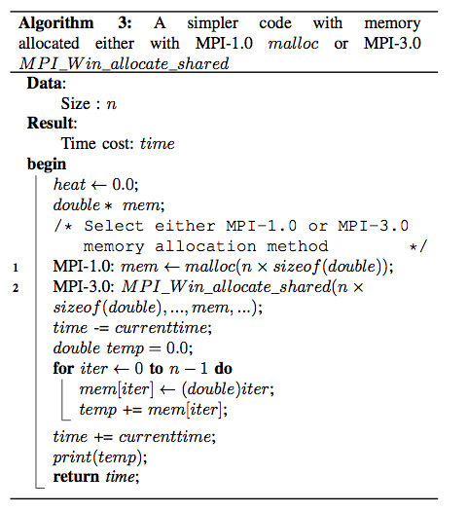
Overhead Analysis and Solutions
Methods
We abstracted the algorithm to a simpler one:
Single application (one mpiexec)
Single process computation
Simple memory assignment
The only difference between the message-passing (MPI-1) and shared memory (MPI-3) implementations is the memory-allocating methods

Slide 228
Performance Comparison (single process)
Matrix Size: 10K x 10K doubles

Slide 229
Problem 1: Compiler Interference
“malloc” is special
glibc has a special attribute decoration, __attribute__((__malloc__))
Tells the compiler that the allocated buffer does not contain pointers to other memory regions
By modifying this buffer or anything derived from this buffer, I cannot update other memory locations in the code (no aliasing semantics)
In contrast, MPI_Win_allocate_shared returns the memory allocated through the baseptr argument instead of the return value, and hence does not have this attribute
If MPI_Win_allocate_shared was modified to not return an error code, but to return the buffer, we could have used the above trick!
MPI_Win_allocate_shared(MPI_Aint size, int disp_unit,
MPI_Info info, MPI_Comm comm, void *baseptr, MPI_Win *win)

Slide 230
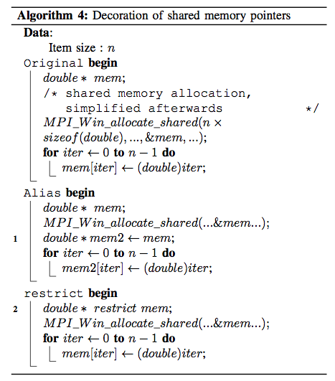
Overhead Analysis and Solutions

Slide 231
Performance Comparison (single process)
Matrix Size: 10K x 10K doubles

Slide 232
Performance Comparison (multiple processes): Memory Assignment

Slide 233
Problem 2: OS Page Assignment Interference
OS treats regular memory allocation and shared memory allocation differently
Single process memory allocation internally does an anonymous mmap
The OS “likes” this type of memory allocations and assigns large pages (2MB) to back such memory
Multi-process memory allocation (shared memory) internally does a file-backed mmap
The OS assigns regular sized pages (4KB) to back such memory

Slide 234
OS Page Assignment Analysis (Memory Assignment)

Slide 235
Overhead Analysis and Solutions
Solutions:
Idea is to modify the OS to give us huge pages for shared memory
There might be a good reason why the OS doesn’t do this by default
We don’t know it, so we will assume we are smarter than everyone else! ☺
System settings (enable hugepage-backed ramfs):
the hugepage number in /proc/sys/vm/nr_hugepages
the group id of huge page in /proc/sys/vm/hugetlb_shm_group
These two can also be done by the sysctl command by the root, or they can be set in the configuration file /etc/sysctl.conf.
Within the MPI implementation, allocate the file backing the shared memory on “hugetlbfs”
We should also be able to detect if the memory we got is huge page backed: can be done, but has not been done yet

Slide 236
Performance Comparison (multiple processes): Memory Assignment

Slide 237
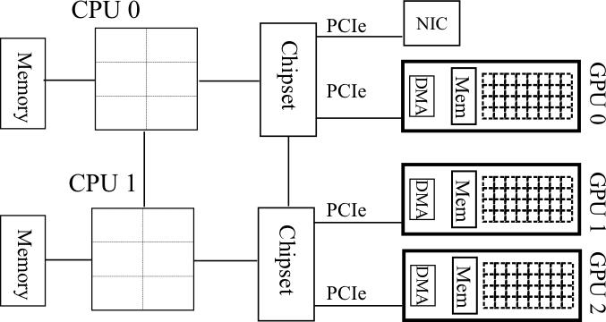
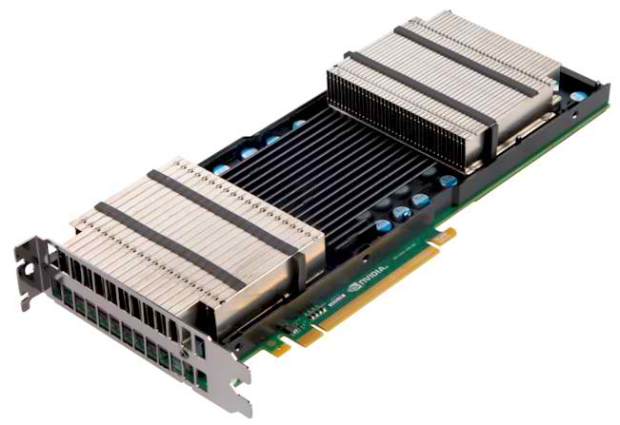
Accelerators in Parallel Computing
General purpose, highly parallel processors
High FLOPs/Watt and FLOPs/$
Unit of execution Kernel
Separate memory subsystem
Prog. Models: CUDA, OpenCL, …
Clusters with accelerators are becoming common
New programmability and performance challenges for programming models and runtime systems

Slide 238
Hybrid Programming with Accelerators
Many users are looking to use accelerators within their MPI applications
The MPI standard does not provide any special semantics to interact with accelerators
Current MPI threading semantics are considered sufficient by most users
There are some research efforts for making accelerator memory directly accessibly by MPI, but those are not a part of the MPI standard

Slide 239
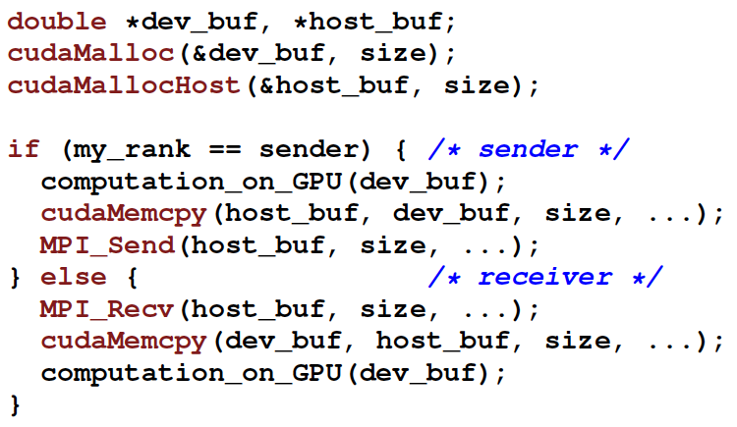
Current Model for MPI+Accelerator Applications
GPU
GPU
P0
P1
P2
P3
GPU
GPU

Slide 240
Alternate MPI+Accelerator models being studied
Some MPI implementations (MPICH, Open MPI, MVAPICH) are investigating how the MPI implementation can directly send/receive data from accelerators
Unified virtual address (UVA) space techniques where all memory (including accelerator memory) is represented with a “void *”
Communicator and datatype attribute models where users can inform the MPI implementation of where the data resides
Clear performance advantages demonstrated in research papers, but these features are not yet a part of the MPI standard (as of MPI-3.1)
Could be incorporated in a future version of the standard

Slide 241
What we will cover in this tutorial
What is MPI?
How to write a simple program in MPI
Running your application with MPICH
Slightly more advanced topics:
Non-blocking communication in MPI
Group (collective) communication in MPI
MPI Datatypes
Advanced topics:
Nonblocking Collectives
One-sided communication
Hybrid Programming
Network locality and Topology
What’s coming in MPI-4
Conclusions and Final Q/A

Slide 242
Topology Mapping and Neighborhood Collectives
Topology mapping basics
Allocation mapping vs. rank reordering
Ad-hoc solutions vs. portability
MPI topologies
Cartesian
Distributed graph
Collectives on topologies – neighborhood collectives
Use-cases

Slide 243
Topology Mapping Basics
MPI supports rank reordering
Change numbering in a given allocation to reduce congestion or dilation
Sometimes automatic (early IBM SP machines)
Properties
Always possible, but effect may be limited (e.g., in a bad allocation)
Portable way: MPI process topologies
Network topology is not exposed
Manual data shuffling after remapping step

Slide 244
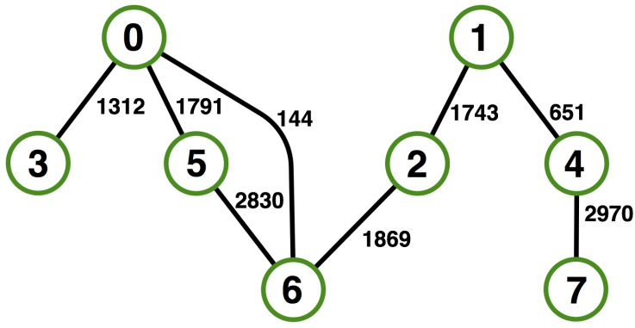

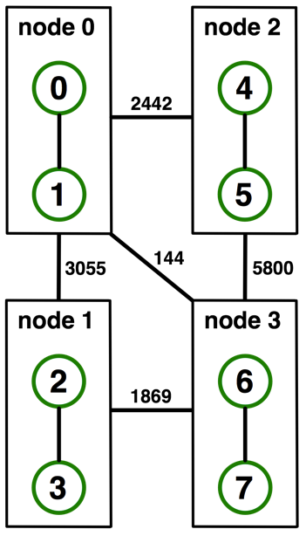
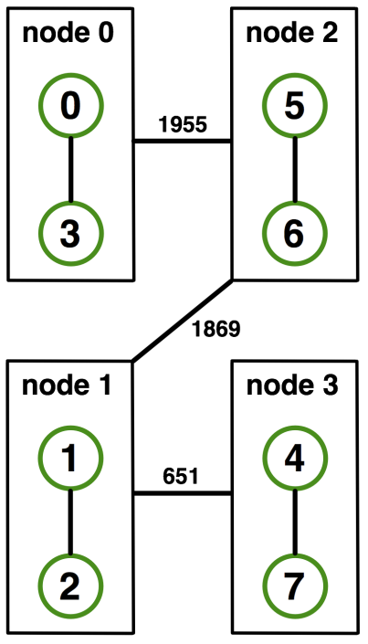
Example: On-Node Reordering
Naïve Mapping
Optimized Mapping
Topomap
Gottschling et al.: Productive Parallel Linear Algebra Programming with Unstructured Topology Adaption

Slide 245
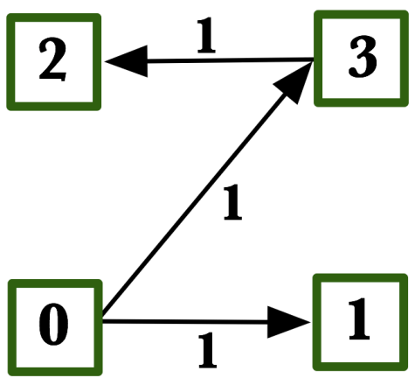
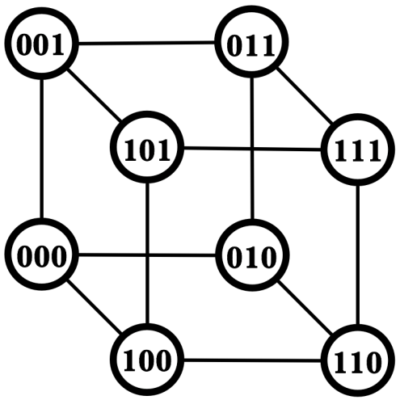
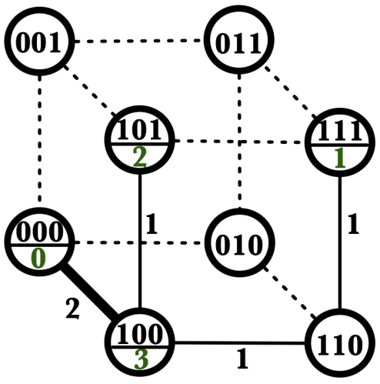
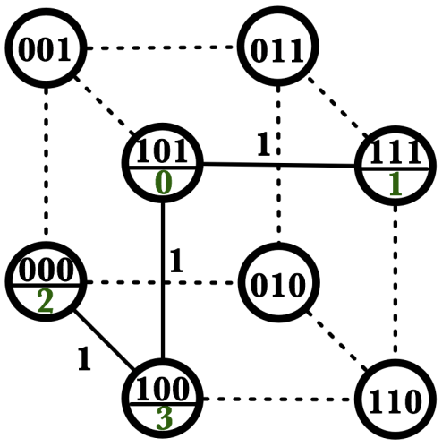
Off-Node (Network) Reordering
Application Topology
Network Topology
Naïve Mapping
Optimal Mapping
Topomap

Slide 246
MPI Topology Intro
Convenience functions (in MPI-1)
Create a graph and query it, nothing else
Useful especially for Cartesian topologies
Query neighbors in n-dimensional space
Graph topology: each rank specifies full graph ☹
Scalable Graph topology (MPI-2.2)
Graph topology: each rank specifies its neighbors or an arbitrary subset of the graph
Neighborhood collectives (MPI-3.0)
Adding communication functions defined on graph topologies (neighborhood of distance one)

Slide 247
MPI_Cart_create
MPI_Cart_create(MPI_Comm comm_old, int ndims, const int *dims,
const int *periods, int reorder, MPI_Comm *comm_cart)
Specify ndims-dimensional topology
Optionally periodic in each dimension (Torus)
Some processes may return MPI_COMM_NULL
Product sum of dims must be <= P
Reorder argument allows for topology mapping
Each calling process may have a new rank in the created communicator
Data has to be remapped manually

Slide 248
MPI_Cart_create Example
int dims[3] = {5,5,5};
int periods[3] = {1,1,1};
MPI_Comm topocomm;
MPI_Cart_create(comm, 3, dims, periods, 0, &topocomm);
Creates logical 3-d Torus of size 5x5x5
But we’re starting MPI processes with a one-dimensional argument (-p X)
User has to determine size of each dimension
Often as “square” as possible, MPI can help!

Slide 249
MPI_Dims_create
MPI_Dims_create(int nnodes, int ndims, int *dims)
Create dims array for Cart_create with nnodes and ndims
Dimensions are as close as possible (well, in theory)
Non-zero entries in dims will not be changed
nnodes must be multiple of all non-zeroes

Slide 250
MPI_Dims_create Example
int p;
MPI_Comm_size(MPI_COMM_WORLD, &p);
MPI_Dims_create(p, 3, dims);
int periods[3] = {1,1,1};
MPI_Comm topocomm;
MPI_Cart_create(comm, 3, dims, periods, 0, &topocomm);
Makes life a little bit easier
Some problems may be better with a non-square layout though

Slide 251
Cartesian Query Functions
Library support and convenience!
MPI_Cartdim_get()
Gets dimensions of a Cartesian communicator
MPI_Cart_get()
Gets size of dimensions
MPI_Cart_rank()
Translate coordinates to rank
MPI_Cart_coords()
Translate rank to coordinates

Slide 252
Cartesian Communication Helpers
MPI_Cart_shift(MPI_Comm comm, int direction, int disp,
int *rank_source, int *rank_dest)
Shift in one dimension
Dimensions are numbered from 0 to ndims-1
Displacement indicates neighbor distance (-1, 1, …)
May return MPI_PROC_NULL
Very convenient, all you need for nearest neighbor communication
No “over the edge” though

Slide 253
Code Example
stencil-mpi-carttopo.c
Adds calculation of neighbors with topology
by
bx

Slide 254

MPI_Graph_create
MPI_Graph_create(MPI_Comm comm_old, int nnodes,
const int *index, const int *edges, int reorder,
MPI_Comm *comm_graph)
Don’t use!!!!!
nnodes is the total number of nodes
index i stores the total number of neighbors for the first i nodes (sum)
Acts as offset into edges array
edges stores the edge list for all processes
Edge list for process j starts at index[j] in edges
Process j has index[j+1]-index[j] edges

Slide 255
Distributed graph constructor
MPI_Graph_create is discouraged
Not scalable
Not deprecated yet but hopefully soon
New distributed interface:
Scalable, allows distributed graph specification
Either local neighbors or any edge in the graph
Specify edge weights
Meaning undefined but optimization opportunity for vendors!
Info arguments
Communicate assertions of semantics to the MPI library
E.g., semantics of edge weights

Slide 256
MPI_Dist_graph_create_adjacent
MPI_Dist_graph_create_adjacent(MPI_Comm comm_old,
int indegree, const int sources[],
const int sourceweights[],
int outdegree, const int destinations[],
const int destweights[], MPI_Info info, int reorder,
MPI_Comm *comm_dist_graph)
indegree, sources, ~weights – source proc. Spec.
outdegree, destinations, ~weights – dest. proc. spec.
info, reorder, comm_dist_graph – as usual
directed graph
Each edge is specified twice, once as out-edge (at the source) and once as in-edge (at the dest)

Slide 257
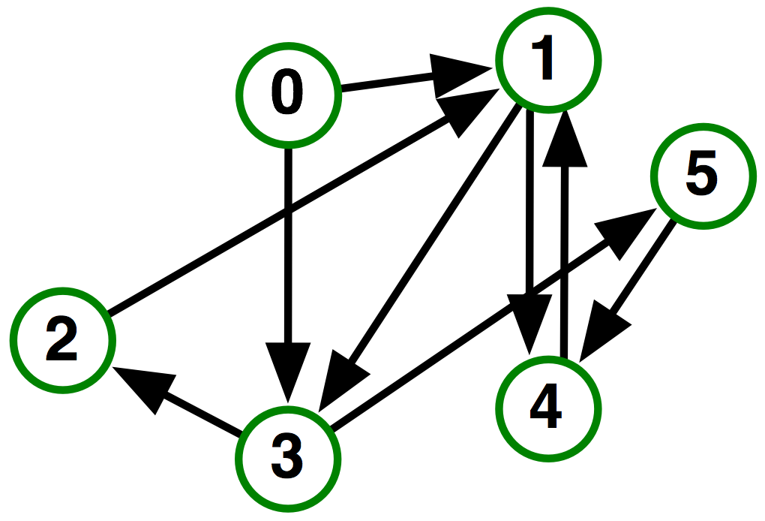
MPI_Dist_graph_create_adjacent
Process 0:
Indegree: 0
Outdegree: 2
Dests: {3,1}
Process 1:
Indegree: 3
Outdegree: 2
Sources: {4,0,2}
Dests: {3,4}
…

Slide 258
MPI_Dist_graph_create
MPI_Dist_graph_create(MPI_Comm comm_old, int n,
const int sources[], const int degrees[],
const int destinations[], const int weights[], MPI_Info info,
int reorder, MPI_Comm *comm_dist_graph)
n – number of source nodes
sources – n source nodes
degrees – number of edges for each source
destinations, weights – dest. processor specification
info, reorder – as usual
More flexible and convenient
Requires global communication
Slightly more expensive than adjacent specification

Slide 259
MPI_Dist_graph_create
Process 0:
N: 2
Sources: {0,1}
Degrees: {2,1} *
Dests: {3,1,4}
Process 1:
N: 2
Sources: {2,3}
Degrees: {1,1}
Dests: {1,2}
…
* Note that in this example, process 0 specifies only one of the two outgoing edges
of process 1; the second outgoing edge needs to be specified by another process

Slide 260
Distributed Graph Neighbor Queries
MPI_Dist_graph_neighbors_count(MPI_Comm comm,
int *indegree,int *outdegree, int *weighted)
Query the number of neighbors of calling process
Returns indegree and outdegree!
Also info if weighted
MPI_Dist_graph_neighbors(MPI_Comm comm, int maxindegree,
int sources[], int sourceweights[], int maxoutdegree,
int destinations[],int destweights[])
Query the neighbor list of calling process
Optionally return weights

Slide 261
Further Graph Queries
MPI_Topo_test(MPI_Comm comm, int *status)
Status is either:
MPI_GRAPH (ugs)
MPI_CART
MPI_DIST_GRAPH
MPI_UNDEFINED (no topology)
Enables to write libraries on top of MPI topologies!

Slide 262
Neighborhood Collectives
Topologies implement no communication!
Just helper functions
Collective communications only cover some patterns
E.g., no stencil pattern
Several requests for “build your own collective” functionality in MPI
Neighborhood collectives are a simplified version
Cf. Datatypes for communication patterns!

Slide 263
Cartesian Neighborhood Collectives
Communicate with direct neighbors in Cartesian topology
Corresponds to cart_shift with disp=1
Collective (all processes in comm must call it, including processes without neighbors)
Buffers are laid out as neighbor sequence:
Defined by order of dimensions, first negative, then positive
2*ndims sources and destinations
Processes at borders (MPI_PROC_NULL) leave holes in buffers (will not be updated or communicated)!

Slide 264
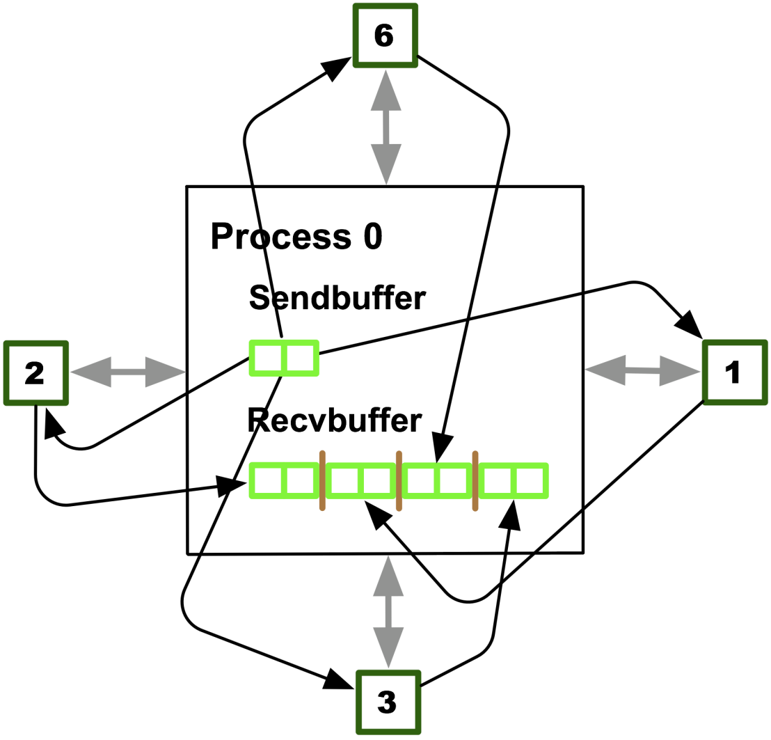
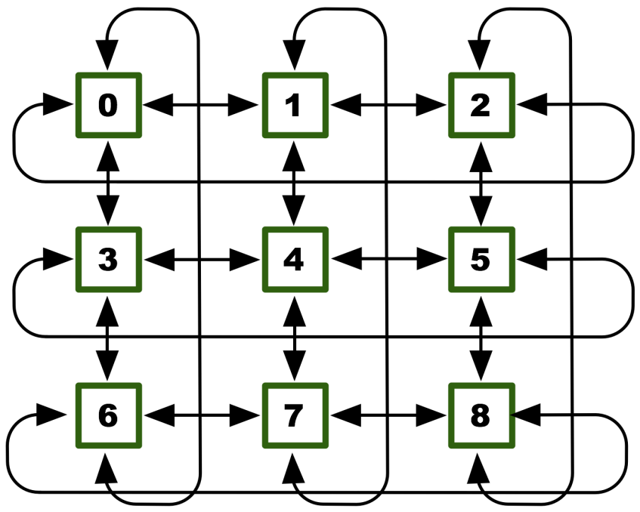
Cartesian Neighborhood Collectives
Buffer ordering example:

Slide 265
Graph Neighborhood Collectives
Collective Communication along arbitrary neighborhoods
Order is determined by order of neighbors as returned by (dist_)graph_neighbors.
Distributed graph is directed, may have different numbers of send/recv neighbors
Can express dense collective operations ☺
Any persistent communication pattern!

Slide 266
MPI_Neighbor_allgather
MPI_Neighbor_allgather(const void* sendbuf, int sendcount,
MPI_Datatype sendtype, void* recvbuf, int recvcount,
MPI_Datatype recvtype, MPI_Comm comm)
Sends the same message to all neighbors
Receives indegree distinct messages
Similar to MPI_Gather
The all prefix expresses that each process is a “root” of his neighborhood
Vector version for full flexibility

Slide 267
MPI_Neighbor_alltoall
MPI_Neighbor_alltoall(const void* sendbuf, int sendcount,
MPI_Datatype sendtype, void* recvbuf, int recvcount,
MPI_Datatype recvtype, MPI_Comm comm)
Sends outdegree distinct messages
Received indegree distinct messages
Similar to MPI_Alltoall
Neighborhood specifies full communication relationship
Vector and w versions for full flexibility

Slide 268
Nonblocking Neighborhood Collectives
MPI_Ineighbor_allgather(…, MPI_Request *req);
MPI_Ineighbor_alltoall(…, MPI_Request *req);
Very similar to nonblocking collectives
Collective invocation
Matching in-order (no tags)
No wild tricks with neighborhoods! In order matching per communicator!

Slide 269
Code Example
stencil_mpi_carttopo_neighcolls.c
Adds neighborhood collectives to the topology

Slide 270
What we will cover in this tutorial
What is MPI?
How to write a simple program in MPI
Running your application with MPICH
Slightly more advanced topics:
Non-blocking communication in MPI
Group (collective) communication in MPI
MPI Datatypes
Advanced topics:
Nonblocking Collectives
One-sided communication
Hybrid Programming
Network locality and Topology
What’s coming in MPI-4
Conclusions and Final Q/A

Slide 271
Introduction
The MPI Forum continues to meet once every 3 months to define future versions of the MPI Standard
We describe some of the proposals the Forum is currently considering
None of these topics are guaranteed to be in MPI-4
These are simply proposals that are being considered

Slide 272
MPI Working Groups
Point-to-point communication
Fault tolerance
Hybrid programming
Persistence
Tools interfaces
Large counts: C11 bindings for large counts

Slide 273
Point-to-Point Working Group

Slide 274
Current Topics
Streaming communication
On hold
Batched communication
Initial proposal
Allocate receive
On hold
Receive reduce/accumulate
On hold
Communication relaxation hints
Active discussion

Slide 275
What is an MPI Stream?
From single sender to single receiver only
Joined by an existing communicator
Ordered and reliable
Sender can send any amount of data
Received can receive any amount of data
(up to what is available)

Slide 276
Discussion issues with MPI streams
Datatypes as the unit of transmission
Normal message boundaries would be ignored
Flow-control/buffering
E.g., receiver consistently slower than sender
Allow buffer underrun or block receiver?
E.g., receiver wants 33 integers, but only 16 are available
Performance benefits discussion

Slide 277


Genome Assembly
Genome analysis
Sequence alignment
Sequence assembly
Reconstruct long DNA sequences by merging many small fragments
Gene mapping
Hard to read whole genomes in current sequencing technology.
Instead, read many small fragments , called “reads”.
Sequencing
Break into
small “reads”
CCT
AGTTCCCTGGAACCGTGAC…
AGT
DNA Samples
Reads
Represent reads as
De Bruijn graph
Assembly
Search & merge
overlapping reads
GGAAC
TTC
CTGGA
AGT
GTT
TCC
AGTTC
GAG
CCG
Remove erroneous links
Output long contigs
AGTTCCCTGGAACCGTGA
AGTTCCCTGGAACCGTGA
[Adapted from National Human Genome Research Institute]

Slide 278
Massive Data Movement in SWAP-Assembly
Basic edge merging algorithm
remote nodes
Step 2, 3
ACGCGATTCAG
GCGATTCAGTA
Send local DNA unit to that node;
Search matching unit on that node;
Merge two units on that node;
Return merged unit.
Step 1
ACGCGATTCAGTA
local node
remote search
ACGCGATTCAG
DNA consensus sequence
Step 4
(64Bytes ~ 1MBytes for single message)
Large amount of outstanding data movement
10⁶+ outstanding messages
per process
(Human genome on Cray Edison *)
process (sender)
memory
DNA units 1: ACGCGATTCAG
DNA reads
* 64GB memory per node, 1KB memory per DNA reads, exclude runtime memory consumption.
merging results
DNA units 2: GCATAGTATCG
DNA reads
process (server 1)
DNA units 3: ATGAGGCATAC
merging results
DNA reads
process (server 2)
merging results
process (server 3)

Slide 279
Issues with Traditional MPI_Isend/MPI_Irecv
Each operation creates a new request object
MPI library runs out of request objects after a few thousand operations
Application cannot issue a lot of messages to fully utilize the network

Slide 280
Batched Communication Operations
Ability to batch multiple operations into a single request object
MPI_Request_batch_init
MPI_Isend_batch, MPI_Irecv_batch, …
Proportionally reduced number of requests
Can allow applications to consolidate multiple completions into a single request

Slide 281
Allocate Receive
MPI_Arecv: the receive buffer is an output argument instead of an input argument, and the implementation allocates that memory internally
Allows implementation to allocate memory for the size of the message, eliminates buffering overhead when message size is not known a priori
Allows copy-free implementation of unexpected messages using an eager-like protocol

Slide 282
Receive reduce/accumulate
MPI_Recv_{reduce,accumulate}: the incoming data is reduced/accumulated onto the receive buffer.
Matches a common application pattern during boundary element exchange and allows implementation to minimize buffering in this case and potentially do more efficiently.
Useful for creating user-defined, potentially dynamic reduction trees, without graph communicators.
May allow for more efficient implementation of some forms of active-messages.

Slide 283
Communication Relaxation Hints
mpi_assert_no_any_tag
The process will not use MPI_ANY_TAG
mpi_assert_no_any_source
The process will not use MPI_ANY_SOURCE
mpi_assert_exact_length
Receive buffers must be correct size for messages
mpi_assert_overtaking_allowed
All messages are logically concurrent

Slide 284
Meeting Details
Teleconference calls
Fortnightly on Monday at 11:00 central US
Email list:
mpiwg-p2p@lists.mpi-forum.org
Face-to-face meetings
http://meetings.mpi-forum.org/Meeting_details.php

Slide 285
Fault Tolerance Working Group

Slide 286
Improved Support for Fault Tolerance
MPI always had support for error handlers and allows implementations to return an error code and remain alive
MPI Forum working on additional support for MPI-4
Current proposal handles fail-stop process failures (not silent data corruption or Byzantine failures)
If a communication operation fails because the other process has failed, the function returns error code MPI_ERR_PROC_FAILED
User can call MPI_Comm_shrink to create a new communicator that excludes failed processes
Collective communication can be performed on the new communicator
Lots of other details in the proposal…

Slide 287
What is the working group doing?
Decide the best way forward for fault tolerance in MPI.
Currently looking at User Level Failure Mitigation (ULFM), but that’s only part of the puzzle.
Look at all parts of MPI and how they describe error detection and handling.
Error handlers probably need an overhaul
Allow clean error detection even without recovery
Consider alternative proposals and how they can be integrated or live alongside existing proposals.
Reinit, FA-MPI, others
Start looking at the next thing
Data resilience?

Slide 288
Noncatastrophic Errors
Currently the state of MPI is undefined if any error occurs
Even simple errors such as arguments are incorrect, can cause the state of MPI to be undefined
Noncatastrophic errors are an opportunity for the MPI implementation to define some errors as “ignorable”
For an error, the user can query if it is catastrophic or not
If the error is not catastrophic, the user can simply pretend like (s)he never issued the operation and continue

Slide 289
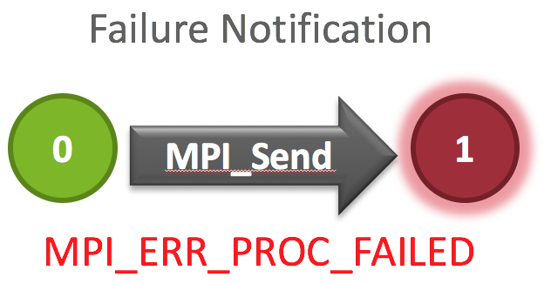
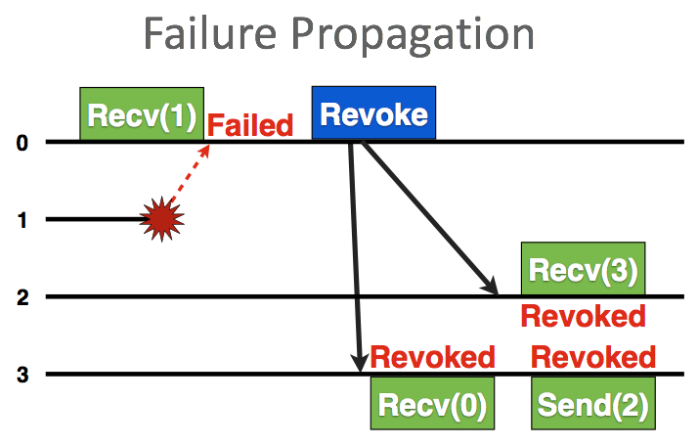
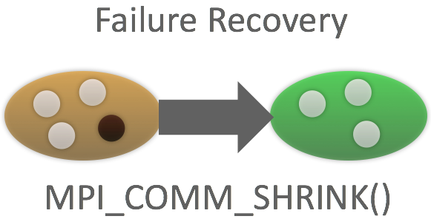
User Level Failure Mitigation Main Ideas
Enable application-level recovery by providing minimal FT API to prevent deadlock and enable recovery
Don’t do recovery for the application, but let the application (or a library) do what is best.
Currently focused on process failure (not data errors or protection)

Slide 290
Is ULFM the only way?
No!
Fenix, presented at SC ‘14 provides more user friendly semantics on top of MPI/ULFM
Other research discussions include
Reinit (LLNL) - Fail fast by causing the entire application to roll back to MPI_INIT with the original number of processes.
FA-MPI (Auburn/UAB) - Transactions allow the user to use parallel try/catch-like semantics to write their application.
Paper in the SC ‘15 Proceedings (ExaMPI Workshop)
Some of these ideas fit with ULFM directly and others require some changes
We’re working with the Tools WG to revamp PMPI to support multiple tools/libraries/etc. which would enable nice fault tolerance semantics.

Slide 291
How Can I Participate?
Website: http://www.github.com/mpiwg-ft
Email: mpiwg-ft@lists.mpi-forum.org
Conference Calls: Every other Tuesday at 3:00 PM Eastern US
In Person: MPI Forum Face To Face Meetings

Slide 292
Hybrid Programming Working Group

Slide 293
MPI Forum Hybrid WG Goals
Ensure interoperability of MPI with other programming models
MPI+threads (pthreads, OpenMP, user-level threads)
MPI+CUDA, MPI+OpenCL
MPI+PGAS models

Slide 294
MPI-3.1 Performance/Interoperability Concerns
Resource sharing between MPI processes
System resources do not scale at the same rate as processing cores
Memory, network endpoints, TLB entries, …
Sharing is necessary
MPI+threads gives a method for such sharing of resources
Performance Concerns
MPI-3.1 provides a single view of the MPI stack to all threads
Requires all MPI objects (requests, communicators) to be shared between all threads
Not scalable to large number of threads
Inefficient when sharing of objects is not required by the user
MPI-3.1 does not allow a high-level language to interchangeably use OS processes or threads
No notion of addressing a single or a collection of threads
Needs to be emulated with tags or communicators

Slide 295
Single view of MPI objects
MPI-3.1 specification requirements
It is valid in MPI to have one thread generate a request (e.g., through MPI_IRECV) and another thread wait/test on it
One thread might need to make progress on another’s requests
Requires all objects to be maintained in a shared space
When a thread accesses an object, it needs to be protected through locks/atomics
Critical sections become expensive with hundreds of threads accessing it
Application behavior
Many (but not all) applications do not require such sharing
A thread that generates a request is responsible for completing it
MPI guarantees are safe, but unnecessary for such applications
P0 (Thread 1) P0 (Thread 2) P1
MPI_Irecv(…, comm1, &req1); MPI_Irecv(…, comm2, &req2); MPI_Ssend(…, comm1);
pthread_barrier(); pthread_barrier(); MPI_Ssend(…, comm2);
MPI_Wait(&req2, …);
pthread_barrier(); pthread_barrier();
MPI_Wait(&req1, …);

Slide 296
Interoperability with High-level Languages
In MPI-3.1, there is no notion of sending a message to a thread
Communication is with MPI processes – threads share all resources in the MPI process
You can emulate such matching with tags or communicators, but some pieces (like collectives) become harder and/or inefficient
Some high-level languages do not expose whether their processing entities are processes or threads
E.g., PGAS languages
When these languages are implemented on top of MPI, the language runtime might not be able to use MPI efficiently

Slide 297
MPI Endpoints: Proposal for MPI-4
Idea is to have multiple addressable communication entities within a single process
Instantiated in the form of multiple ranks per MPI process
Each rank can be associated with one or more threads
Lesser contention for communication on each “rank”
In the extreme case, we could have one rank per thread (or some ranks might be used by a single thread)

Slide 298
MPI Endpoints Semantics
Parent Comm
Parent MPI Process
Parent MPI Process
Parent MPI Process
E.P. Comm
Rank
Rank
Rank
Rank
Rank
Rank
Rank
M
T
T
M
T
T
M
T
T
MPI_Comm_create_endpoints(MPI_Comm parent_comm, int my_num_ep, MPI_Info info, MPI_Comm out_comm_handles[])
Creates new MPI ranks from existing ranks in parent communicator
Each process in parent comm. requests a number of endpoints
Array of output handles, one per local rank (i.e. endpoint) in endpoints communicator
Endpoints have MPI process semantics (e.g. progress, matching, collectives, …)
Threads using endpoints behave like MPI processes
Provide per-thread communication state/resources
Allows implementation to provide process-like performance for threads
Notes:
“M” is the master thread. Not really an important detail, but potentially useful to point out when comparing with MPI+OpenMP

Slide 299
MPI Endpoints Relax the 1-to-1 mapping of ranks to threads/processes
Parent Comm
Parent MPI Process
Parent MPI Process
Parent MPI Process
E.P. Comm
Rank
Rank
Rank
Rank
Rank
Rank
Rank
P
T
T
P
T
T
P
T
T
Parent Comm
0
1
2
E.P. Comm
0
1
2
3
4
5
6
Notes:
I haven’t found an optimal way of explaining endpoints. This is an alternate explanation, that seems to be helpful.
When we create endpoints, we effectively “fork” a process in the parent communicator.

Slide 300
Hybrid MPI+OpenMP Example With Endpoints
int main(int argc, char **argv) {
int world_rank, tl;
int max_threads = omp_get_max_threads();
MPI_Comm ep_comm[max_threads];
MPI_Init_thread(&argc, &argv, MPI_THREAD_MULTIPLE, &tl);
MPI_Comm_rank(MPI_COMM_WORLD, &world_rank);
#pragma omp parallel
{
int nt = omp_get_num_threads();
int tn = omp_get_thread_num();
int ep_rank;
#pragma omp master
{
MPI_Comm_create_endpoints(MPI_COMM_WORLD, nt, MPI_INFO_NULL, ep_comm);
}
#pragma omp barrier
MPI_Comm_rank(ep_comm[tn], &ep_rank);
... // Do work based on ‘ep_rank’
MPI_Allreduce(..., ep_comm[tn]);
MPI_Comm_free(&ep_comm[tn]);
}
MPI_Finalize();
}

Slide 301
Additional Notes
Useful for more than just avoiding locks
Semantics that are “rank-specific” become more flexible
E.g., ordering for operations from a process
Ordering constraints for MPI RMA accumulate operations
Supplementary proposal on thread-safety requirements for endpoint communicators
Is each rank only accessed by a single thread or multiple threads?
Might get integrated into the core proposal
Implementation challenges being looked into
Simply having endpoint communicators might not be useful, if the MPI implementation has to make progress on other communicators too

Slide 302
More Info
Endpoints:
https://svn.mpi-forum.org/trac/mpi-forum-web/ticket/380
Hybrid Working Group:
https://svn.mpi-forum.org/trac/mpi-forum-web/wiki/MPI3Hybrid

Slide 303
Persistence Working Group

Slide 304
Persistent Collective Operations
An all-to-all transfer is done many times in an application
The specific sends and receives represented never change (size, type, lengths, transfers)
A nonblocking persistent collective operation can take the time to apply a heuristic and choose a faster way to move that data
Fixed cost of making those decisions could be high (are amortized over all the times the function is used
Static resource allocation can be done
Choose fast(er) algorithm, take advantage of special cases
Reduce queueing costs
Special limited hardware can be allocated if available
Choice of multiple transfer paths could also be performed

Slide 305
Basics
Mirror regular nonblocking collective operations
For each nonblocking MPI collective, add a persistent variant
For every MPI_I<coll>, add MPI_<coll>_init
Parameters are identical to the corresponding nonblocking variant
All arguments “fixed” for subsequent uses
Persistent collective operations cannot be matched with blocking or nonblocking collective calls

Slide 306
Init/Start
The init function calls only perform initialization; do not start the operation
E.g., MPI_Allreduce_init
Produces a persistent request (not destroyed by completion)
Works with MPI_Start/MPI_Startall (cannot have multiple operations on the same communicator in Startall)
Only inactive requests can be started
MPI_Request_free can free inactive requests

Slide 307
Ordering of Inits and Starts
Inits are nonblocking collective calls and must be ordered
Persistent collective operations must be started in the same order at all processes
Startall cannot contain multiple operations on the same communicator due to ordering ambiguity

Slide 308
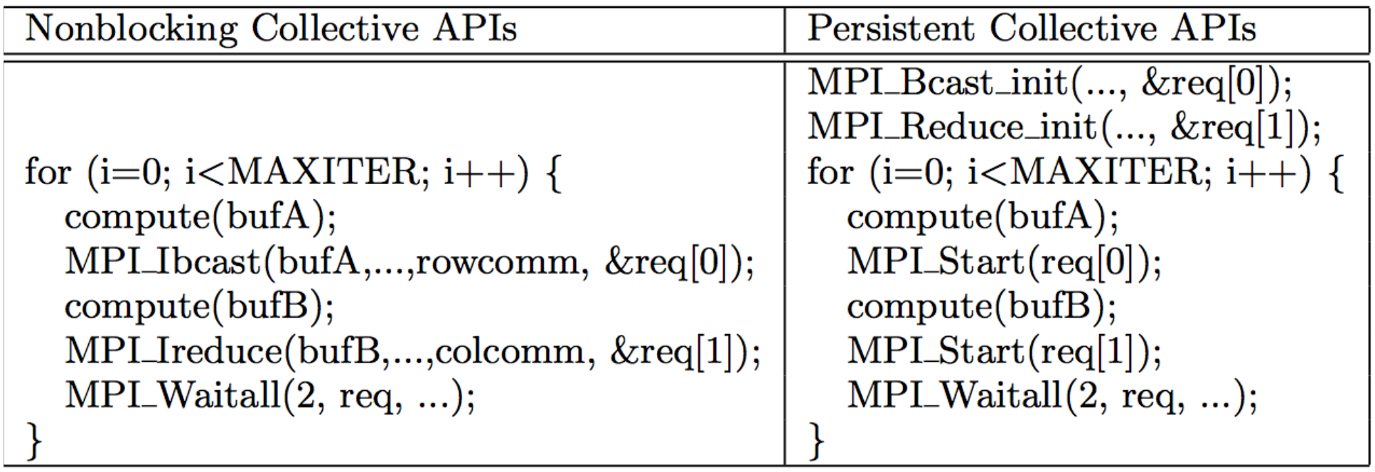
Example

Slide 309
Tools Working Group

Slide 310
Active Proposals (1/2)
New interface to replace PMPI
Known, longstanding problems with the current profiling interface PMPI
One tool at a time can use it
Forces tools to be monolithic (a single shared library)
The interception model is OS dependent
New interface
Callback design
Multiple tools can potentially attach
Maintain all old functionality
New feature for event notification in MPI_T
PERUSE
Tool registers for interesting event and gets callback when it happens

Slide 311
Active Proposals (2/2)
Debugger support - MPIR interface
Fixing some bugs in the original “blessed” document
Missing line numbers!
Support non-traditional MPI implementations
Ranks are implemented as threads
Support for dynamic applications
Commercial applications/ Ensemble applications
Fault tolerance
Handle Introspection Interface
See inside MPI to get details about MPI Objects
Communicators, File Handles, etc.

Slide 312
Can I Join?
Join the mailing list
http://lists.mpi-forum.org/
mpiwg-tools
Join our meetings
https://github.com/mpiwg-tools/tools-issues/wiki/Meetings
Look at the wiki for current topics
https://github.com/mpiwg-tools/tools-issues/wiki

Slide 313
Large Count Working Group

Slide 314
Problem with Large Counts
MPI_Send/Recv and other functions take “int” as the count for data
What happens for data larger than 2GB x datatype size?
You create a new large “contiguous” derived datatype and send that
Possible, but clumsy
What about duplicating all MPI functions to change “int” to “MPI_Count” (which is a large, typically 64-bit, integer)
Doubles the number of MPI functions
Possible, but clumsy

Slide 315
New C11 Bindings
Use C11 _Generic type to provide multiple function prototypes
Like C++ function overloading, but done with compile time macro replacement
MPI_Send will have two function signatures
One for traditional “int” arguments
One for new “MPI_Count” arguments
Fully backward compatible for existing applications
New applications can promote their data lengths to 64-bit without changing functions everywhere

Slide 316
What we will cover in this tutorial
What is MPI?
How to write a simple program in MPI
Running your application with MPICH
Slightly more advanced topics:
Non-blocking communication in MPI
Group (collective) communication in MPI
MPI Datatypes
Advanced topics:
Nonblocking Collectives
One-sided communication
Hybrid Programming
Network locality and Topology
What’s coming in MPI-4
Conclusions and Final Q/A

Slide 317
Conclusions
Parallelism is critical today, given that that is the only way to achieve performance improvement with the modern hardware
MPI is an industry standard model for parallel programming
A large number of implementations of MPI exist (both commercial and public domain)
Virtually every system in the world supports MPI
Gives user explicit control on data management
Widely used by many scientific applications with great success
Your application can be next!

Slide 318
Web Pointers
MPI standard : http://www.mpi-forum.org/docs/docs.html
MPICH : http://www.mpich.org
MPICH mailing list: discuss@mpich.org
MPI Forum : http://www.mpi-forum.org/
Other MPI implementations:
MVAPICH (MPICH on InfiniBand) : http://mvapich.cse.ohio-state.edu/
Intel MPI (MPICH derivative): http://software.intel.com/en-us/intel-mpi-library/
Microsoft MPI (MPICH derivative)
Open MPI : http://www.open-mpi.org/
Several MPI tutorials can be found on the web

Slide 319
New Tutorial Books on MPI
Basic MPI
Advanced MPI, including MPI-3

Slide 320
New Book on Parallel Programming Models
Released at SC15
Edited by Pavan Balaji
MPI: W. Gropp and R. Thakur
GASNet: P. Hargrove
OpenSHMEM: J. Kuehn and S. Poole
UPC: K. Yelick and Y. Zheng
Global Arrays: S. Krishnamoorthy, J. Daily, A. Vishnu, and B. Palmer
Chapel: B. Chamberlain
Charm++: L. Kale, N. Jain, and J. Lifflander
ADLB: E. Lusk, R. Butler, and S. Pieper
Scioto: J. Dinan
SWIFT: T. Armstrong, J. M. Wozniak, M. Wilde, and I. Foster
CnC: K. Knobe, M. Burke, and F. Schlimbach
OpenMP: B. Chapman, D. Eachempati, and S. Chandrasekaran
Cilk Plus: A. Robison and C. Leiserson
Intel TBB: A. Kukanov
CUDA: W. Hwu and D. Kirk
OpenCL: T. Mattson
Pre-order at https://mitpress.mit.edu/models
Discount code: MBALAJI30 (valid till 12/31/2015)

